Slide 1
scholarsphere
Group 20

Slide 2
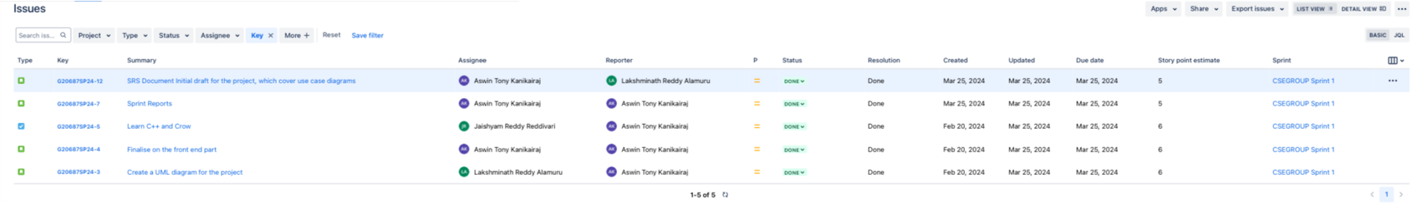
Sprint 1

Slide 3
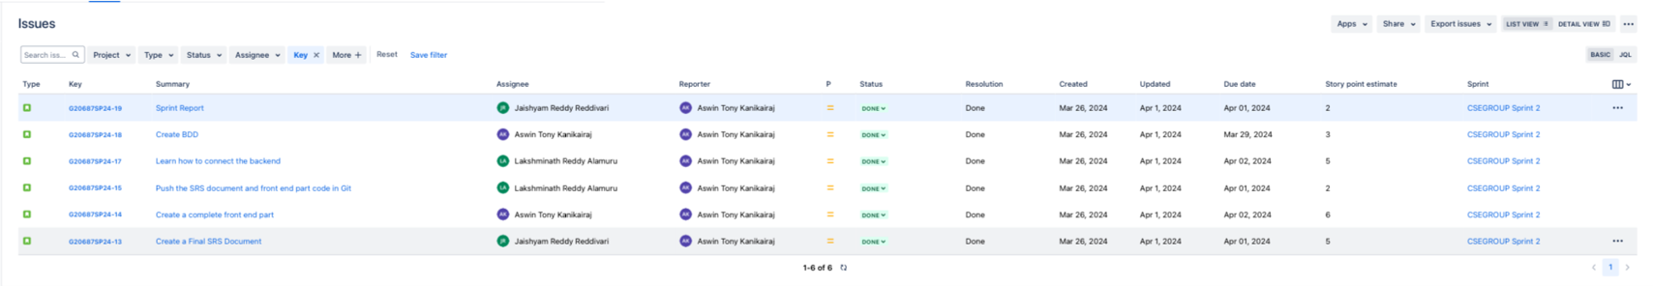
Sprint 2

Slide 4
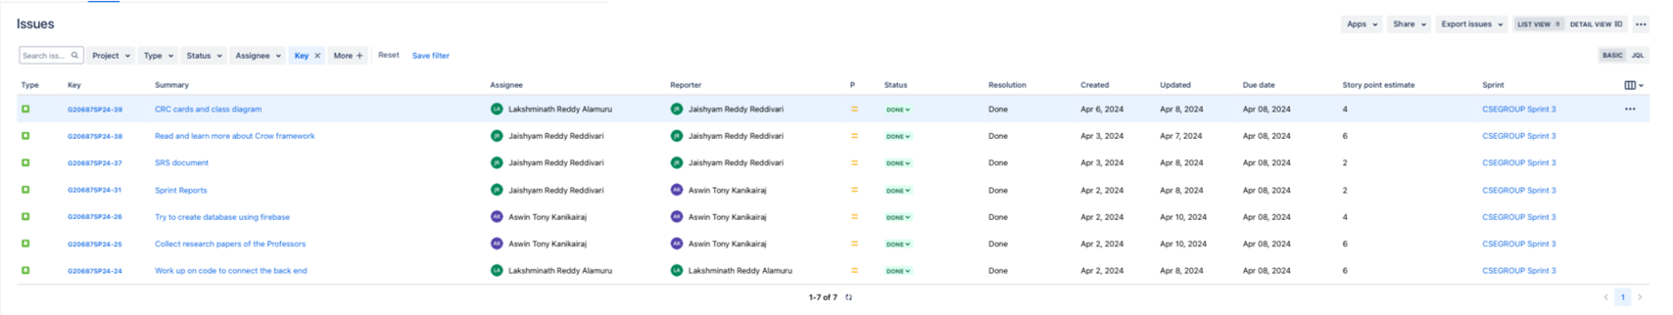
Sprint 3

Slide 5
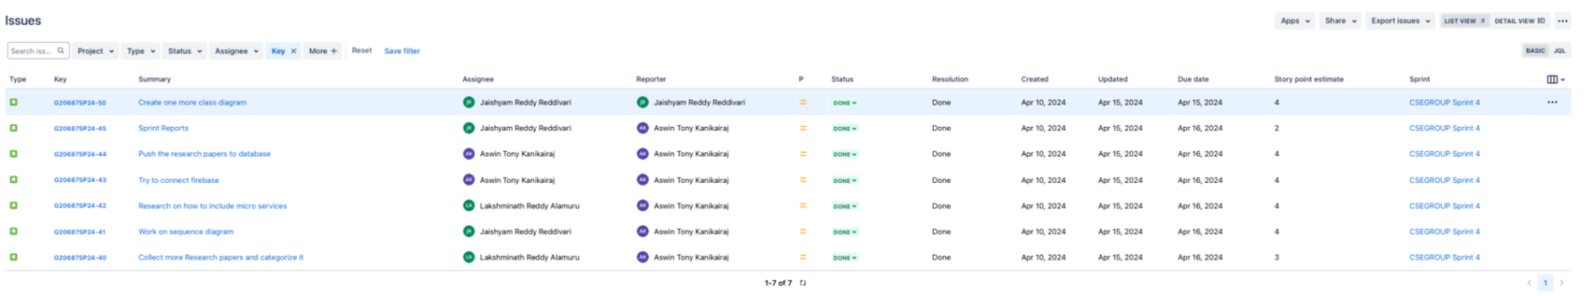
Sprint 4

Slide 6
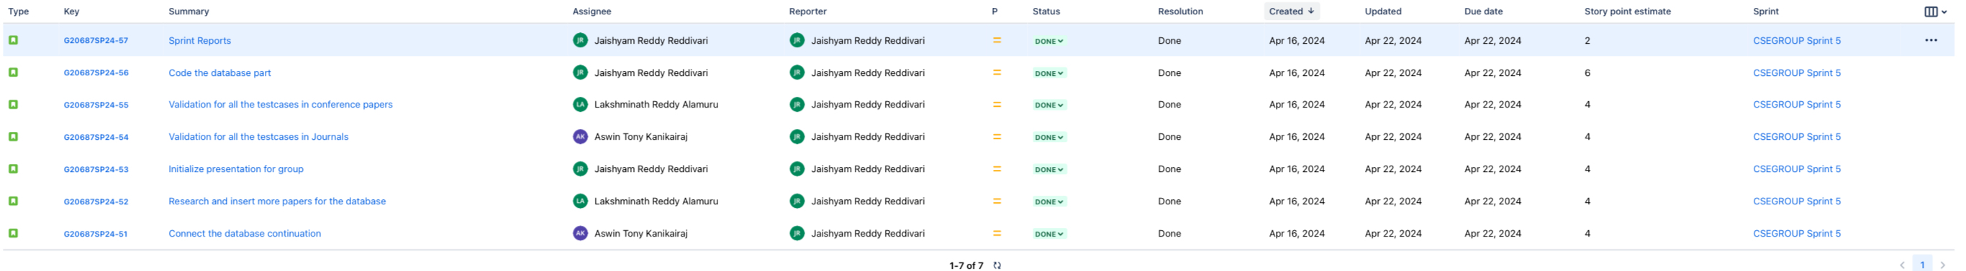
Sprint 5

Slide 7
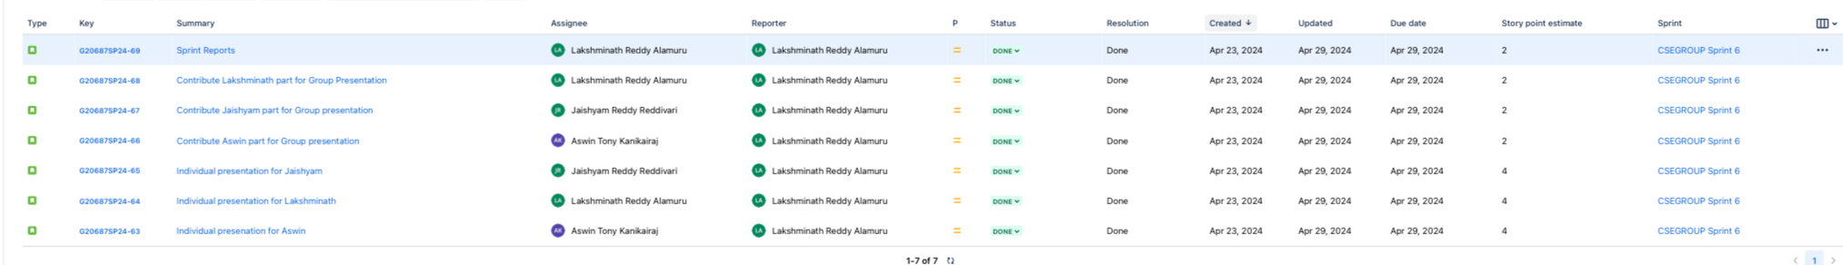
Sprint 6

Slide 8
Sprint 7

Slide 9
Sprint Overview
Sprint | Number of stories closed | Number of stories rolled over | Story points
Sprint 1 | 5 | 0 | 28
Sprint 2 | 6 | 0 | 23
Sprint 3 | 7 | 0 | 30
Sprint 4 | 7 | 0 | 26
Sprint 5 | 6 | 0 | 29
Sprint 6 | 7 | 0 | 20
Sprint 7 | 7 | 0 | 26
The average number of closed stories per sprint are 6.4.
The average number of stories rolled over are 0.
The total number of story points that the team has logged are 182.

Slide 10

ScholarSphere Web Page
Login Page:

Slide 11
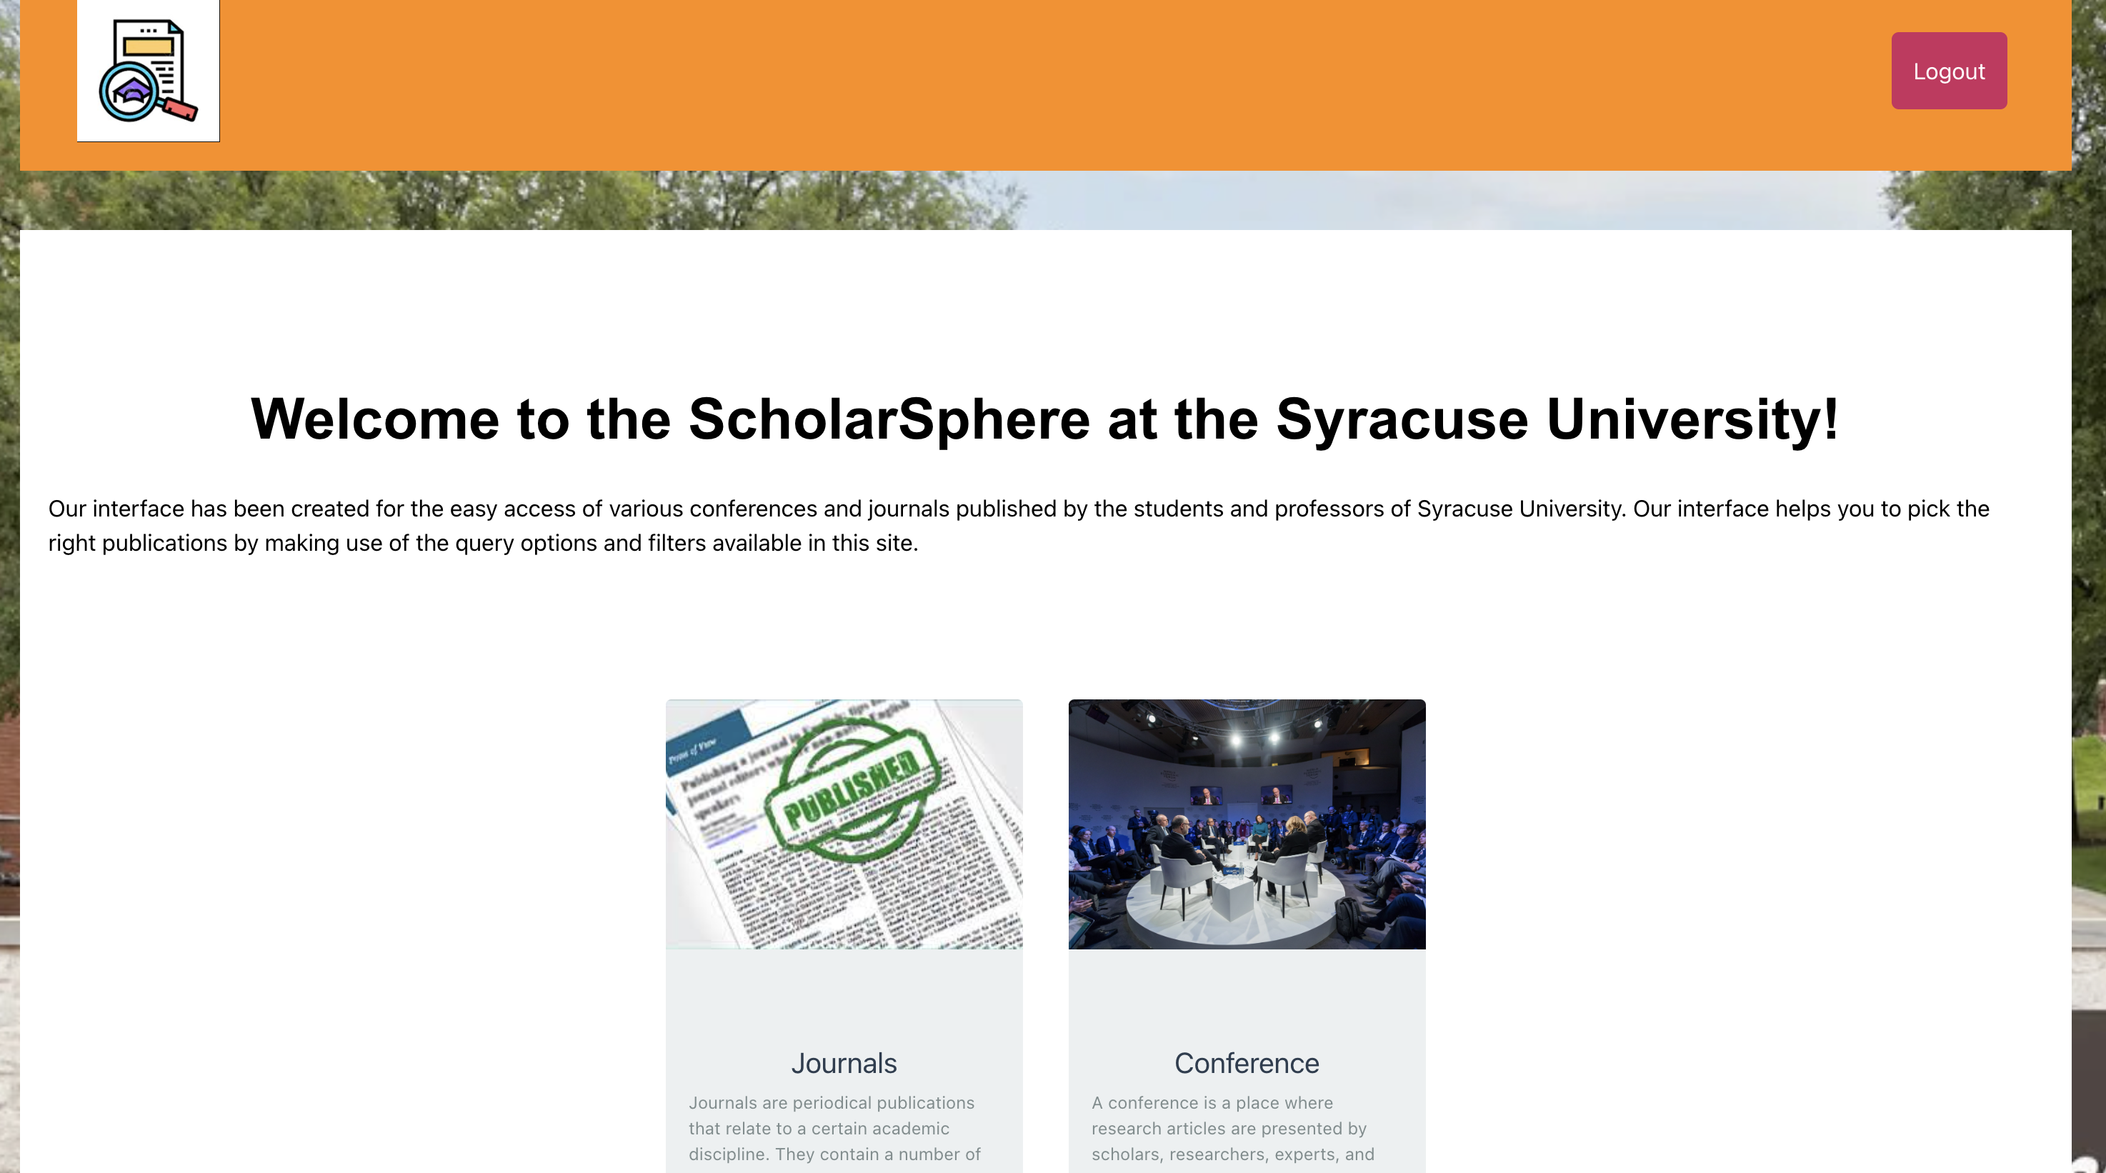
User Interface:

Slide 12
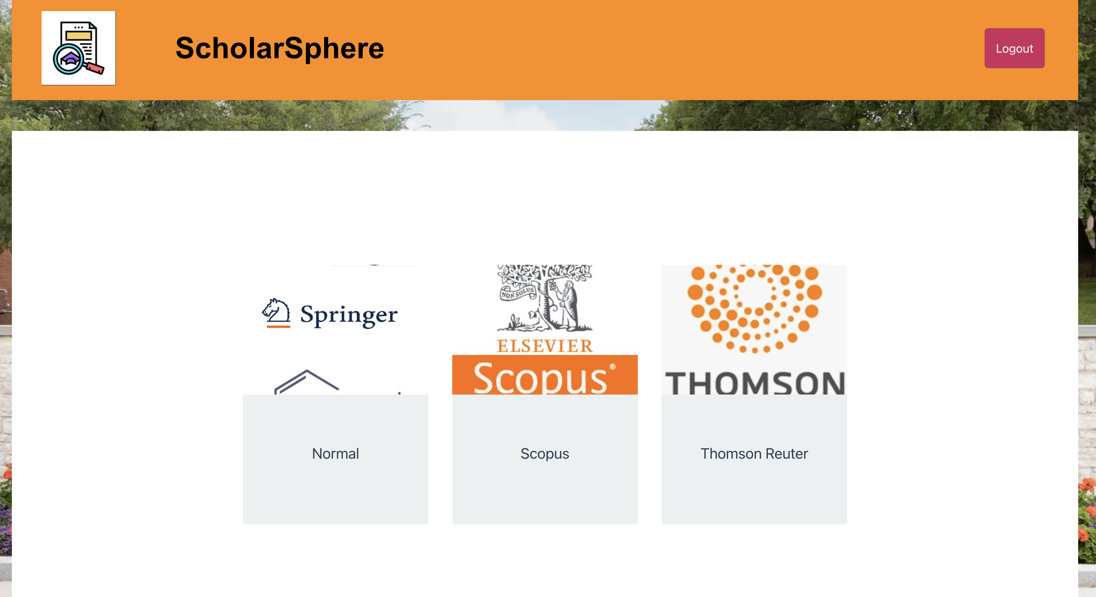
User Interface:

Slide 13
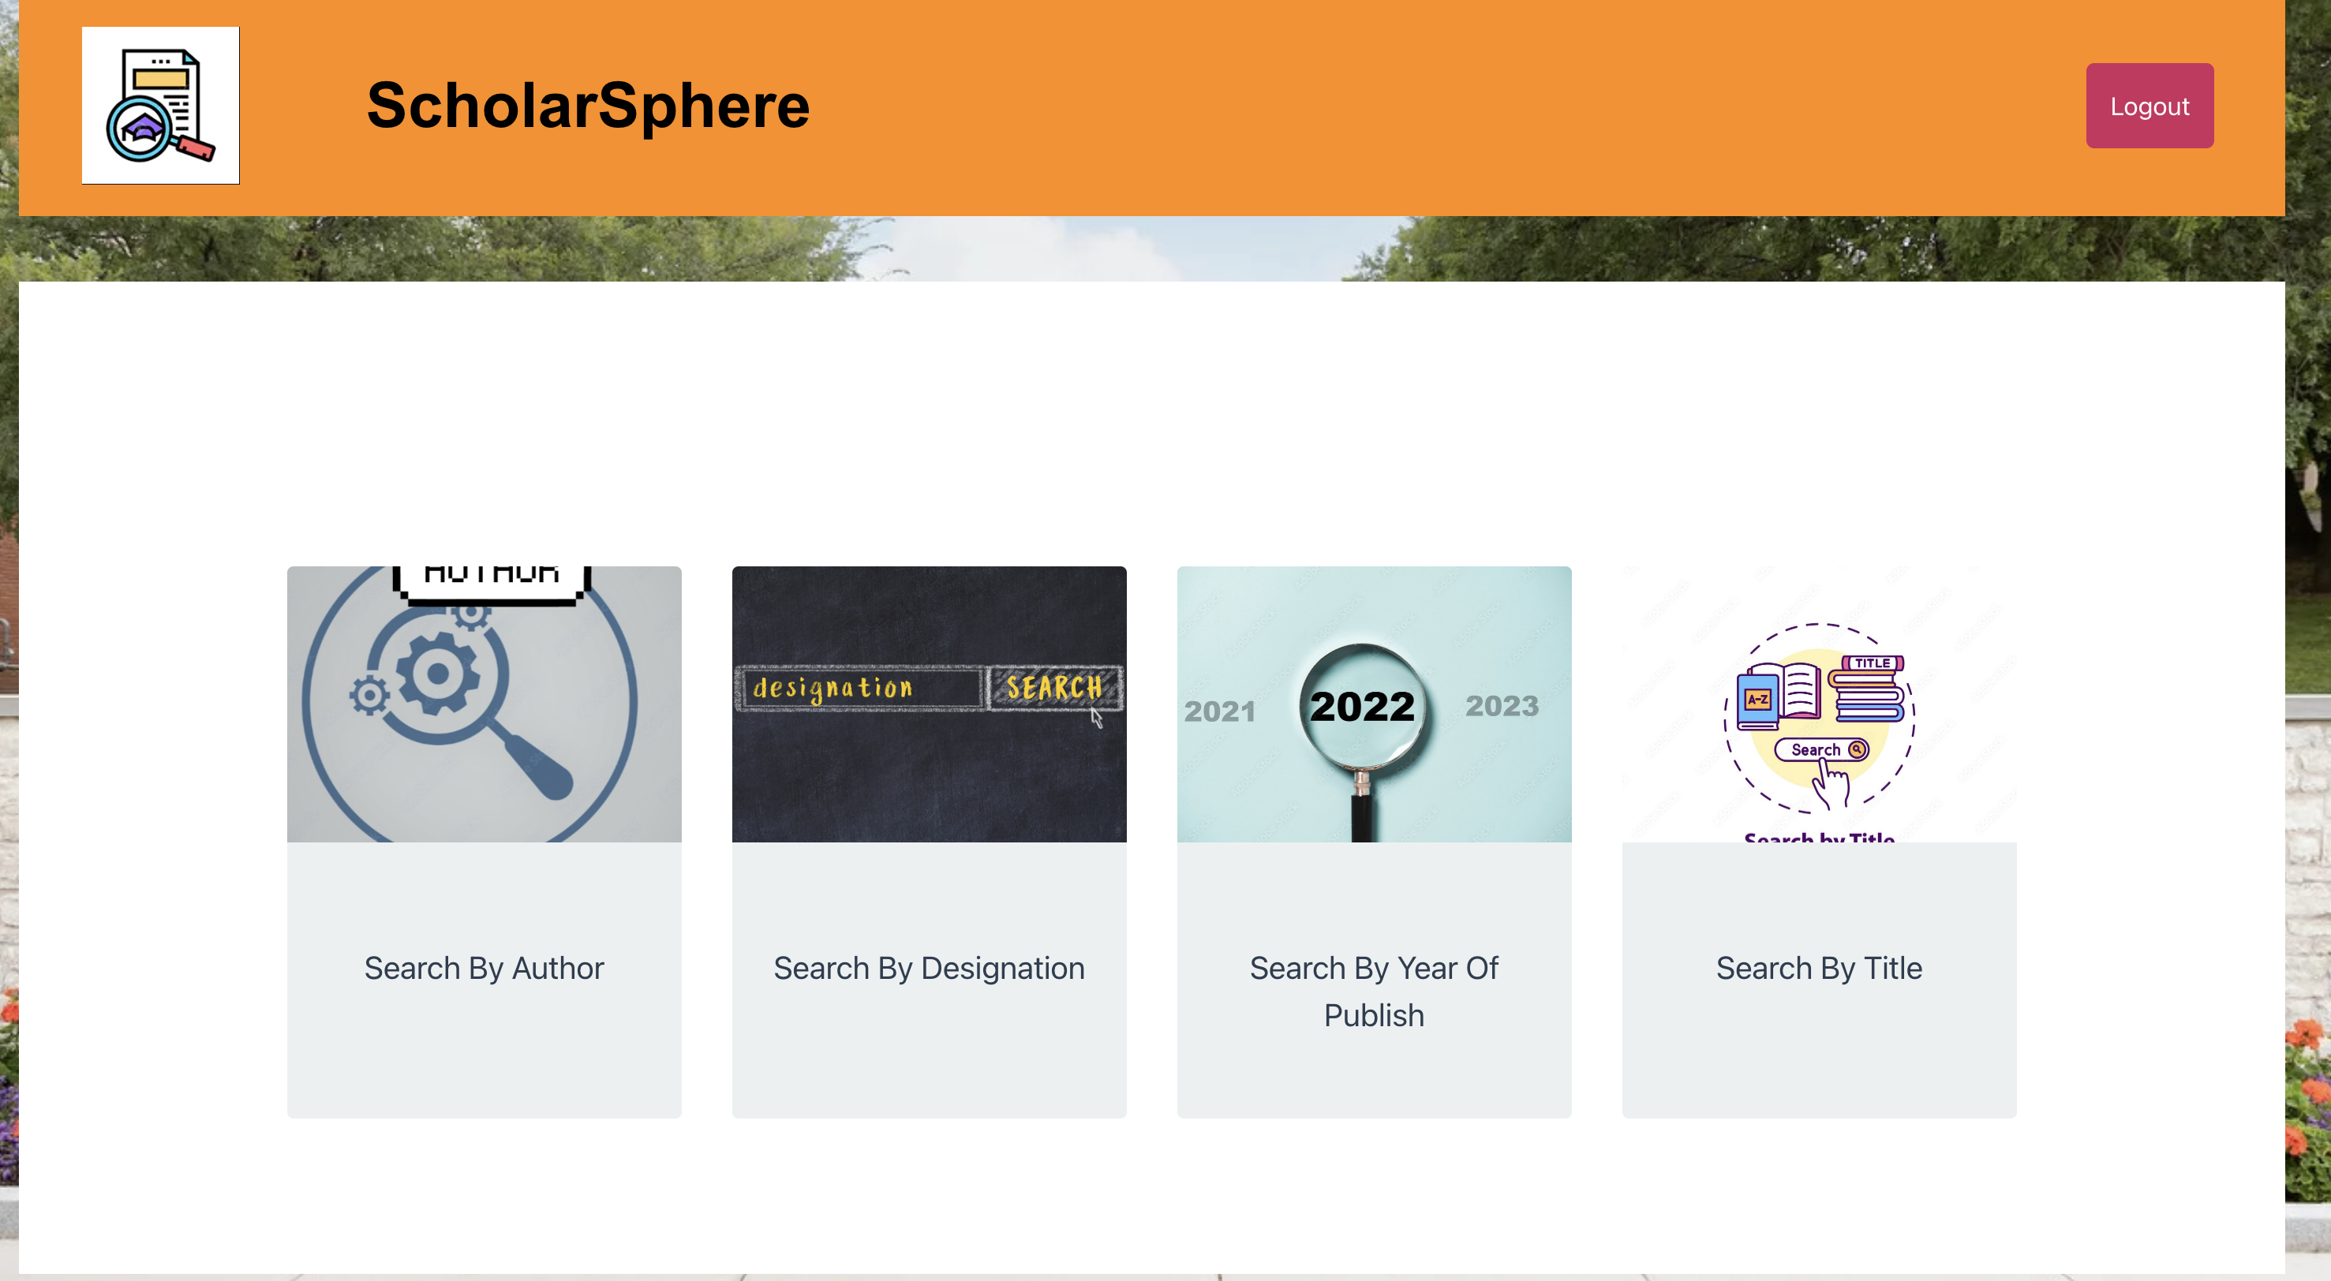
User Interface:

Slide 14
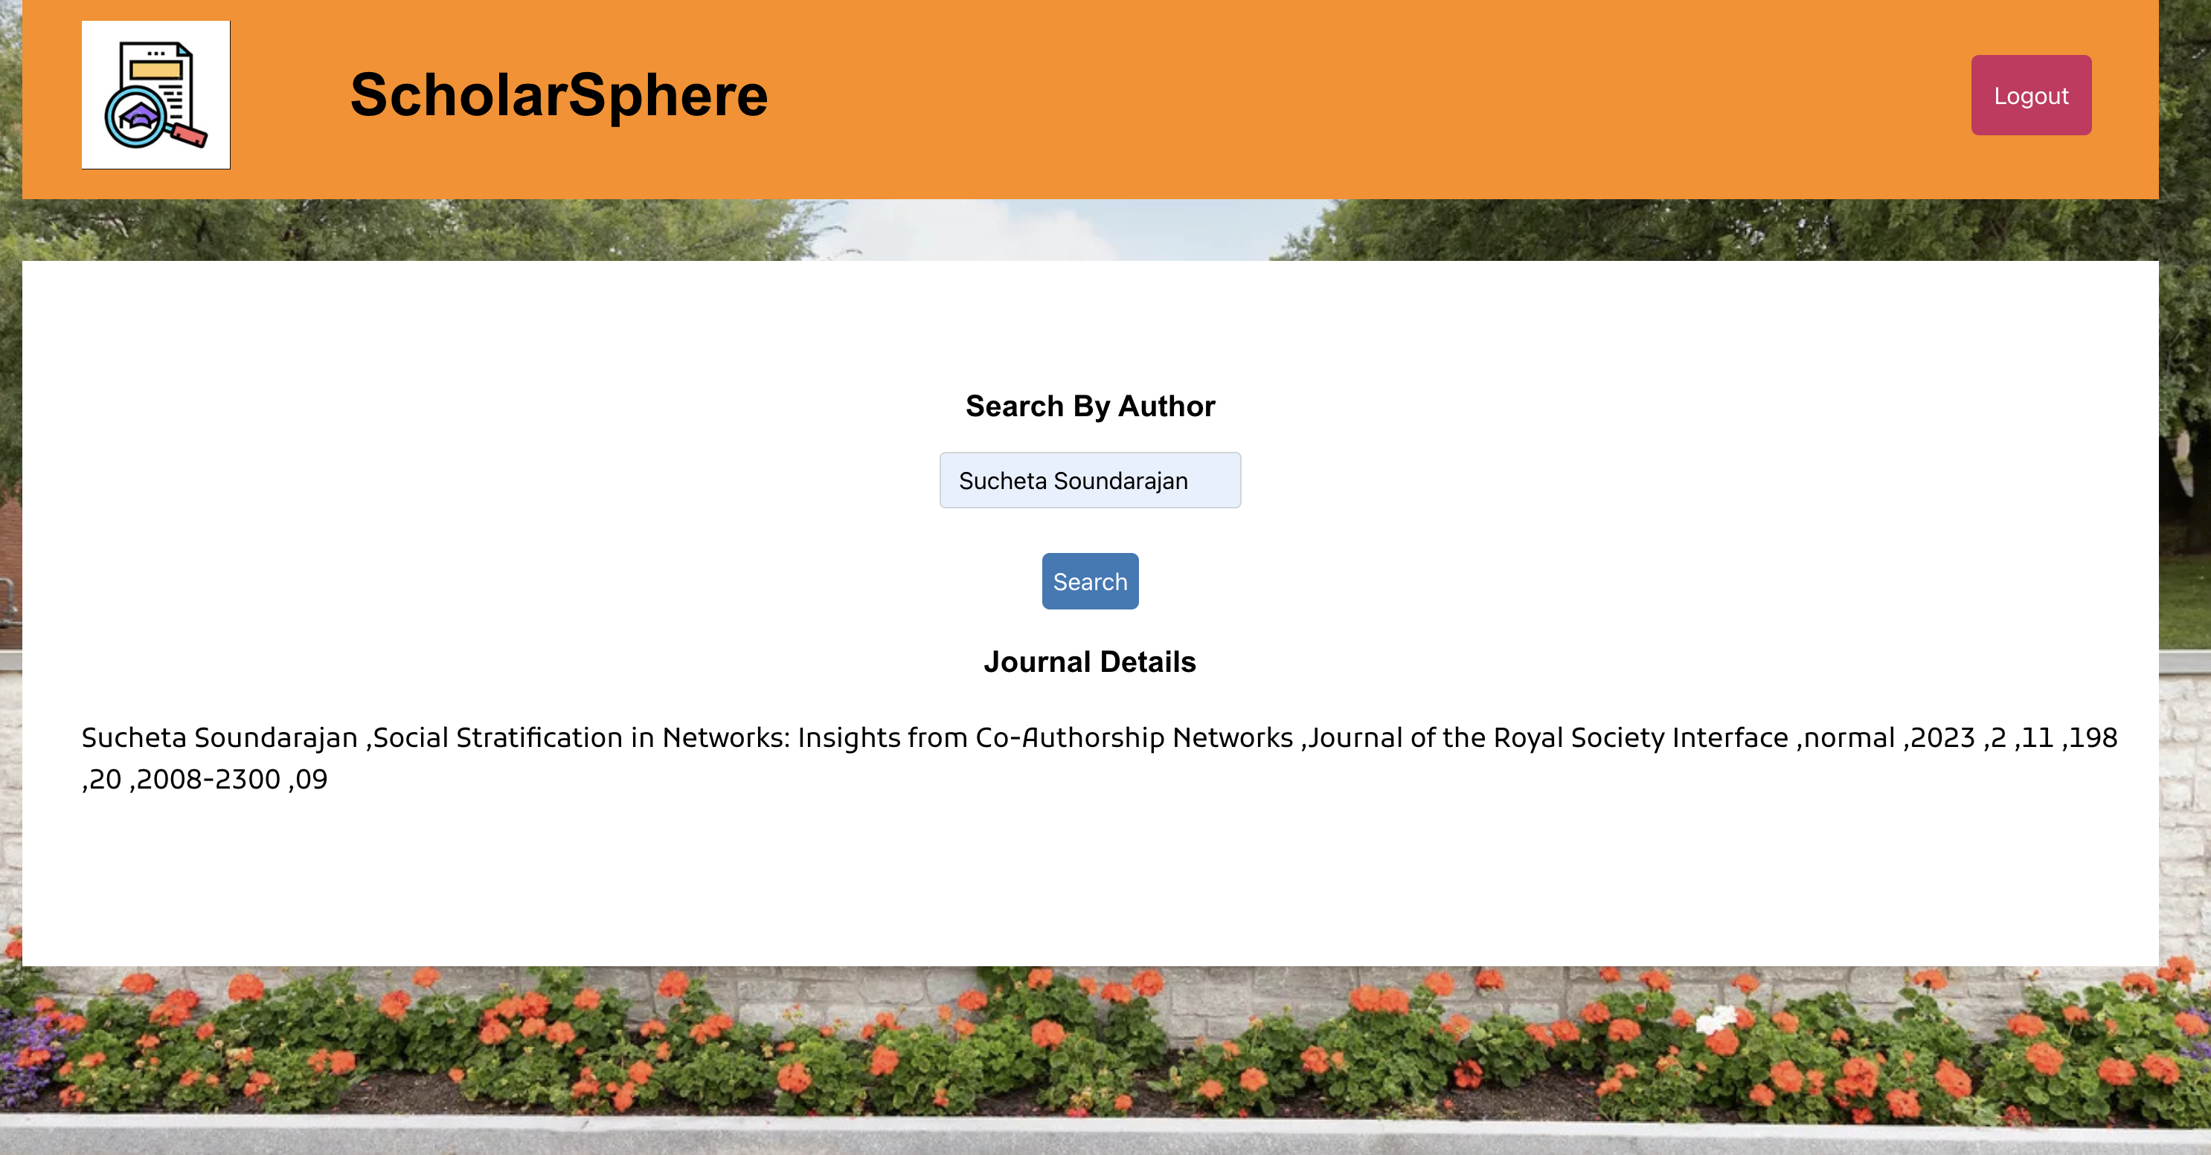
User Interface:

Slide 15
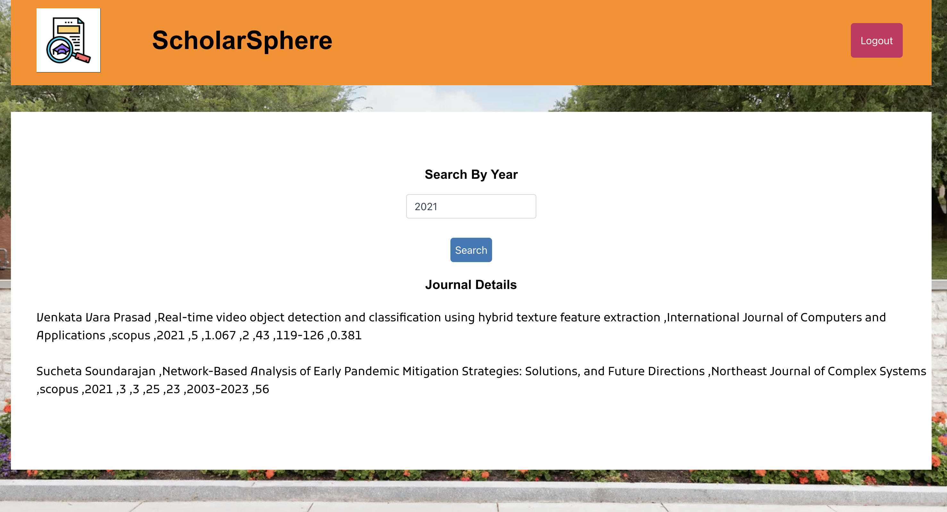
User Interface:

Slide 16
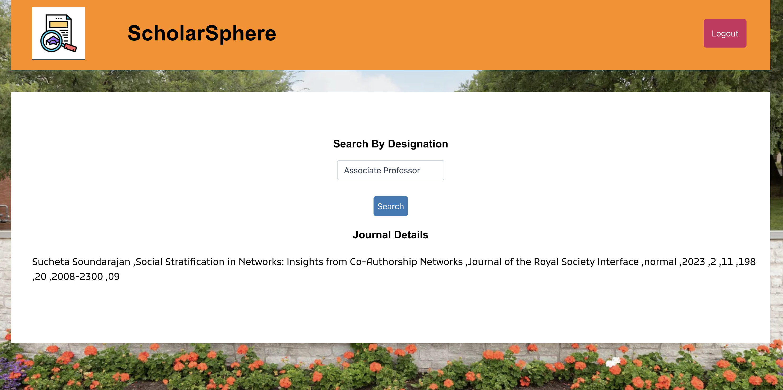
User Interface:

Slide 17
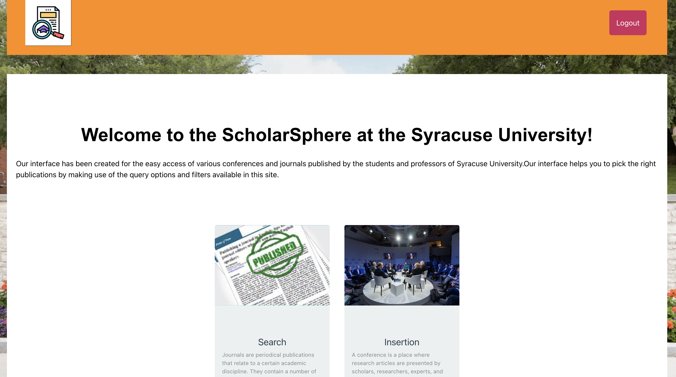
Admin Interface:

Slide 18

Admin Interface:

Slide 19
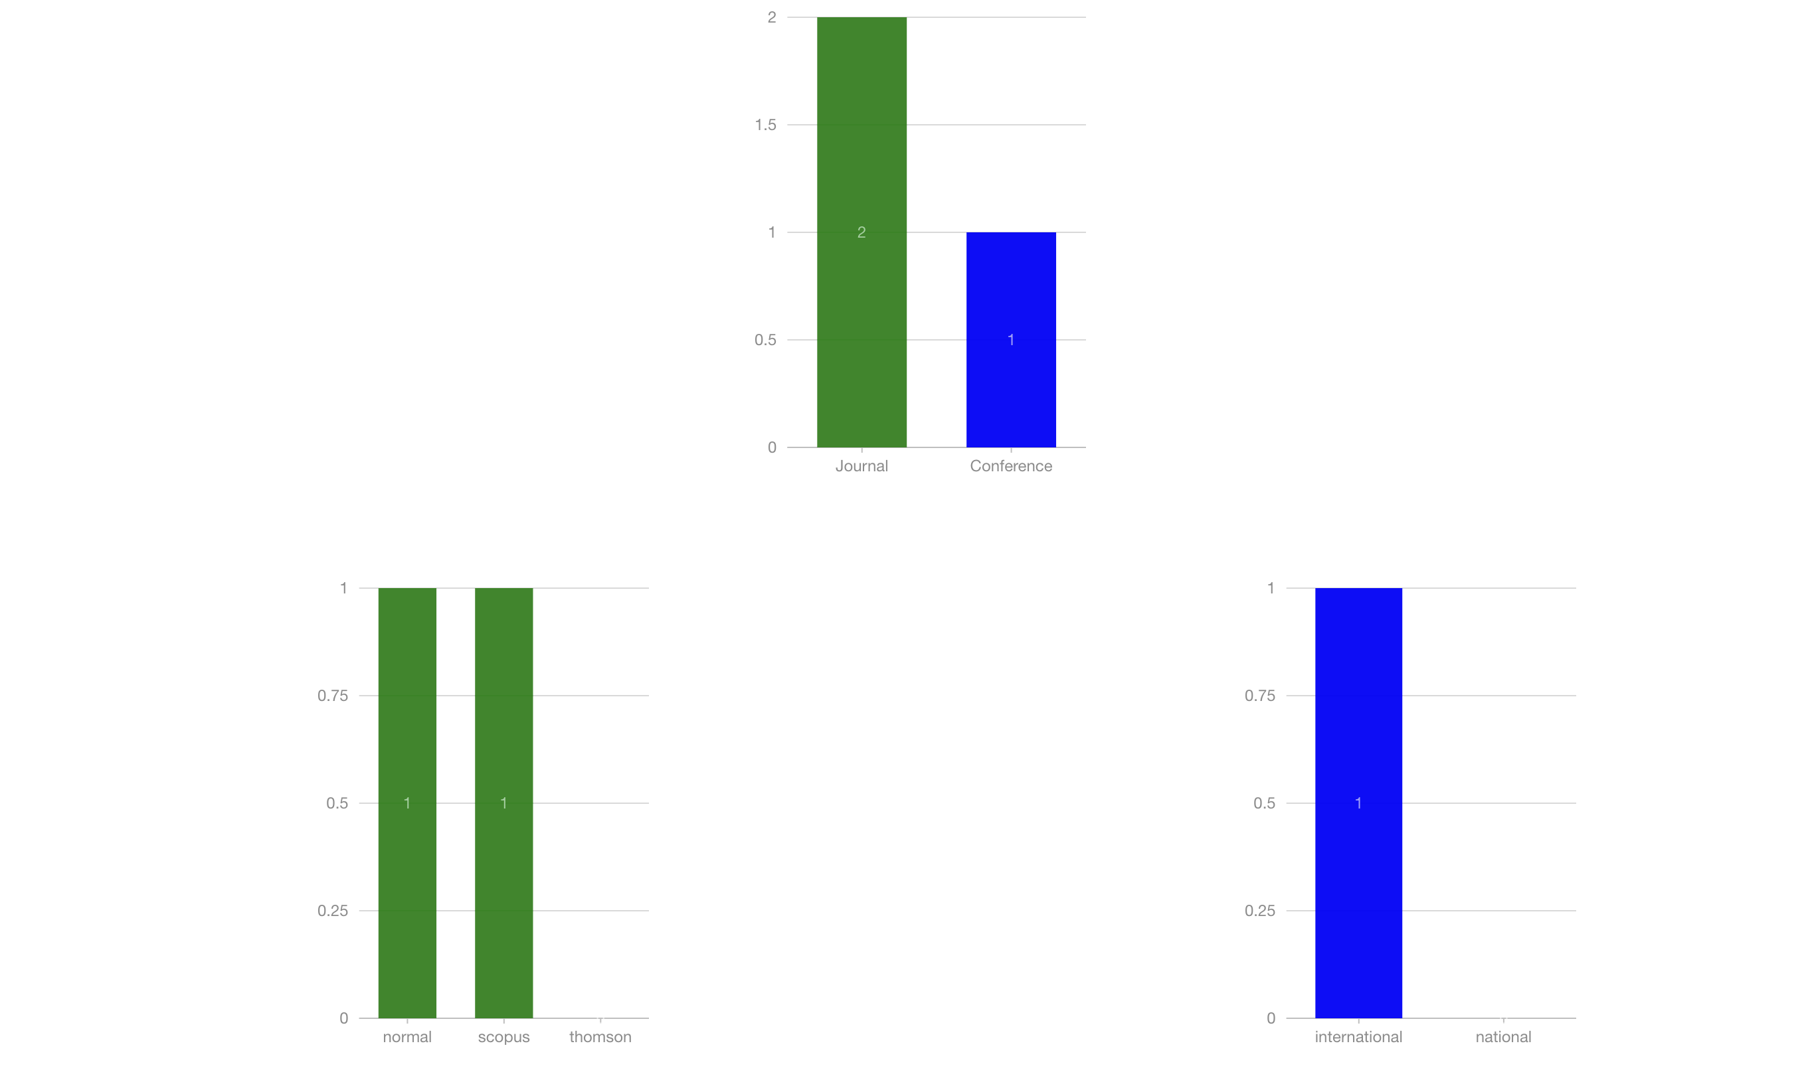
Admin Interface:

Slide 20
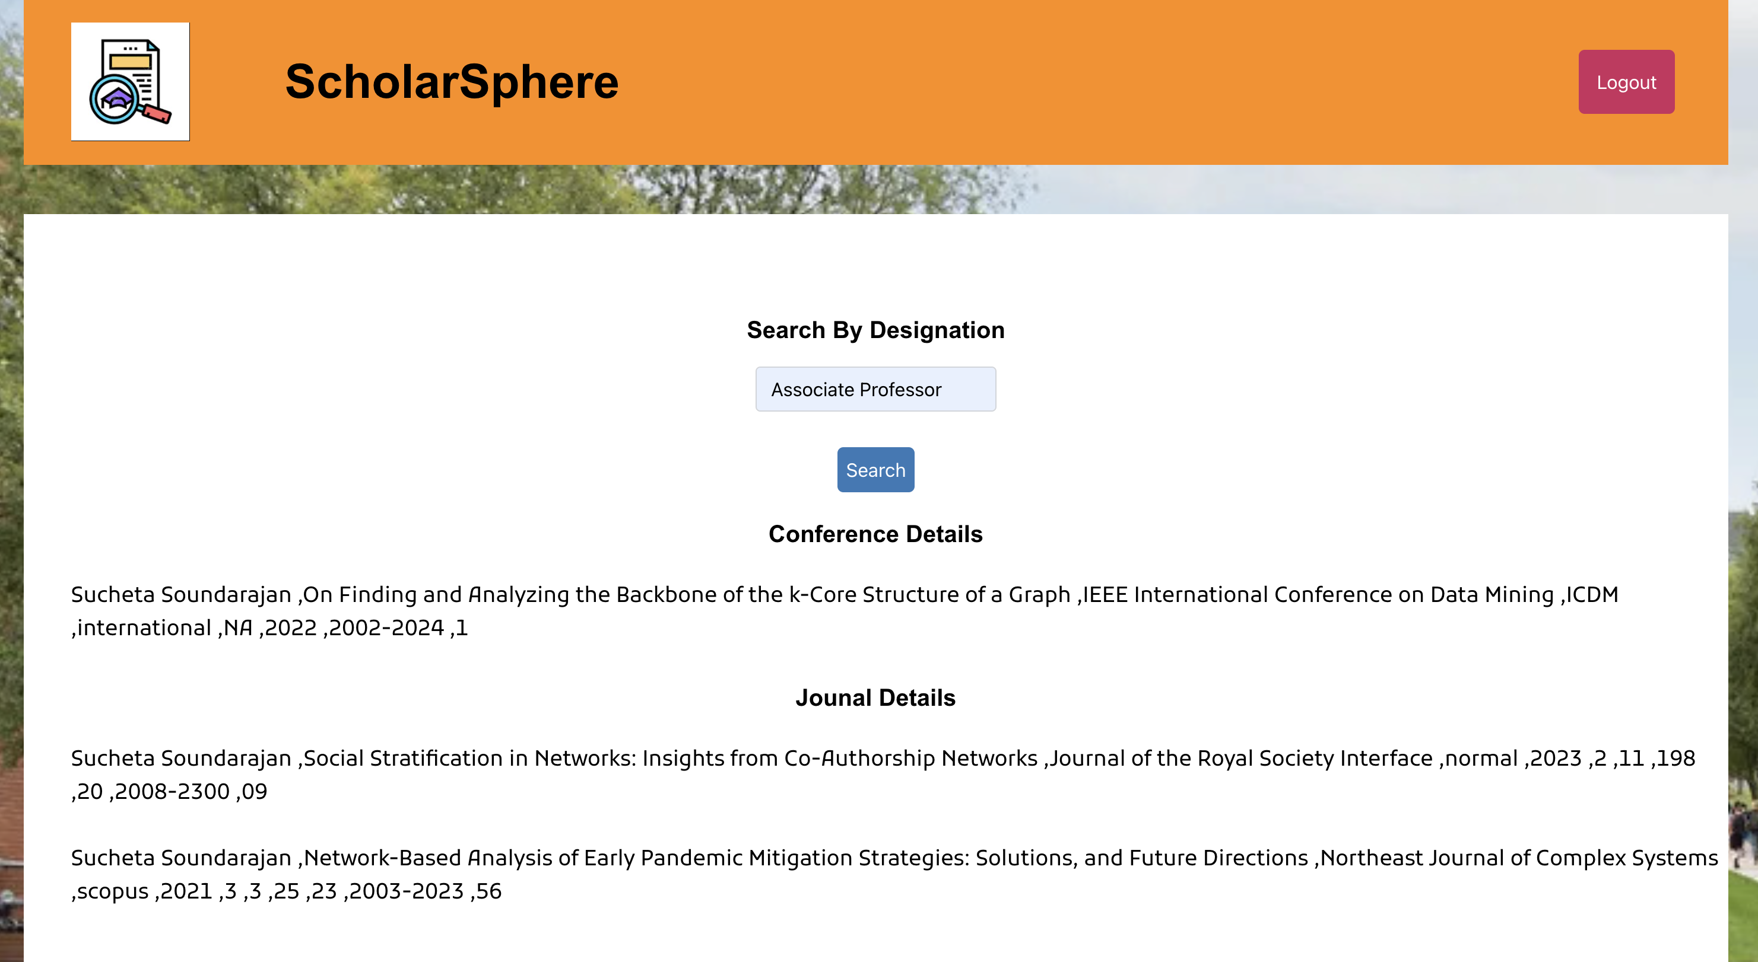
Admin Interface:

Slide 21
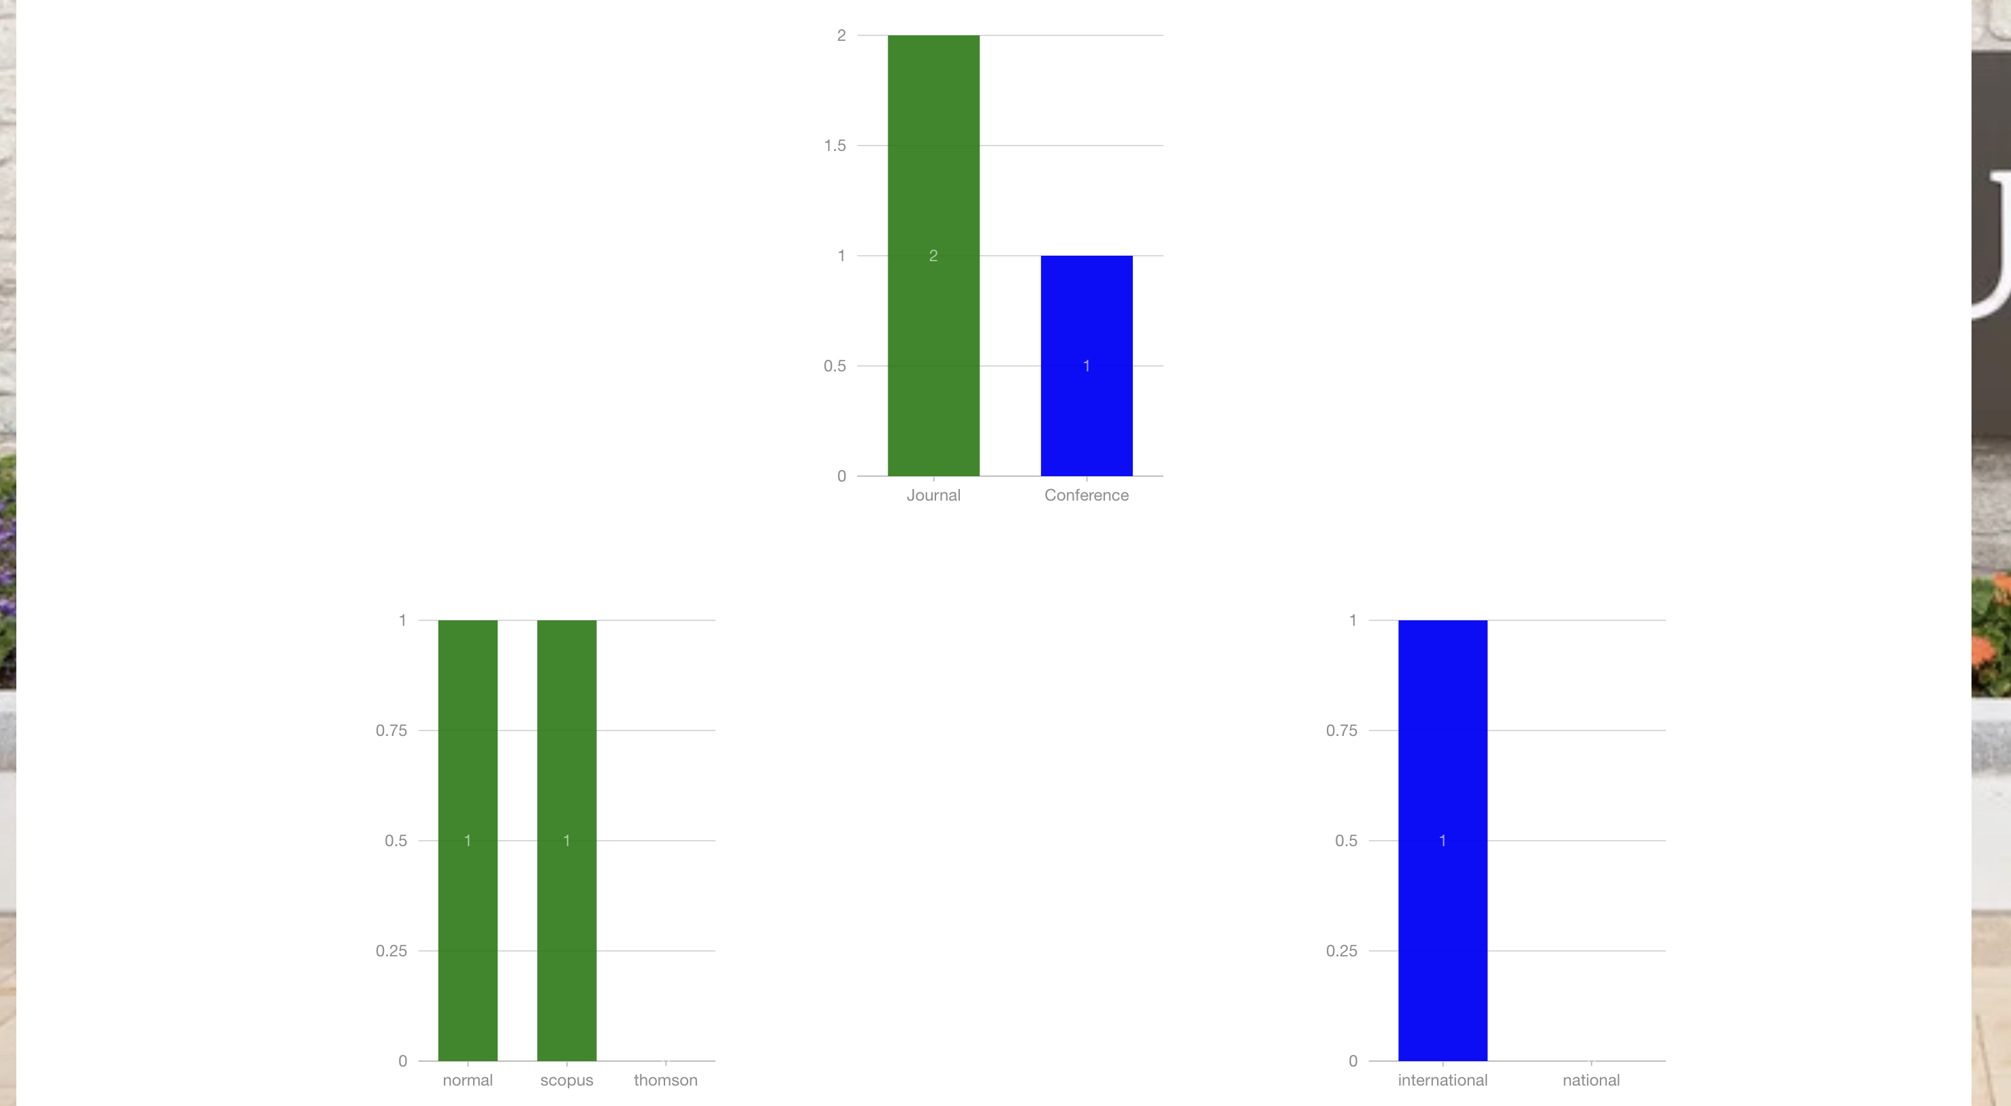
Admin Interface:

Slide 22
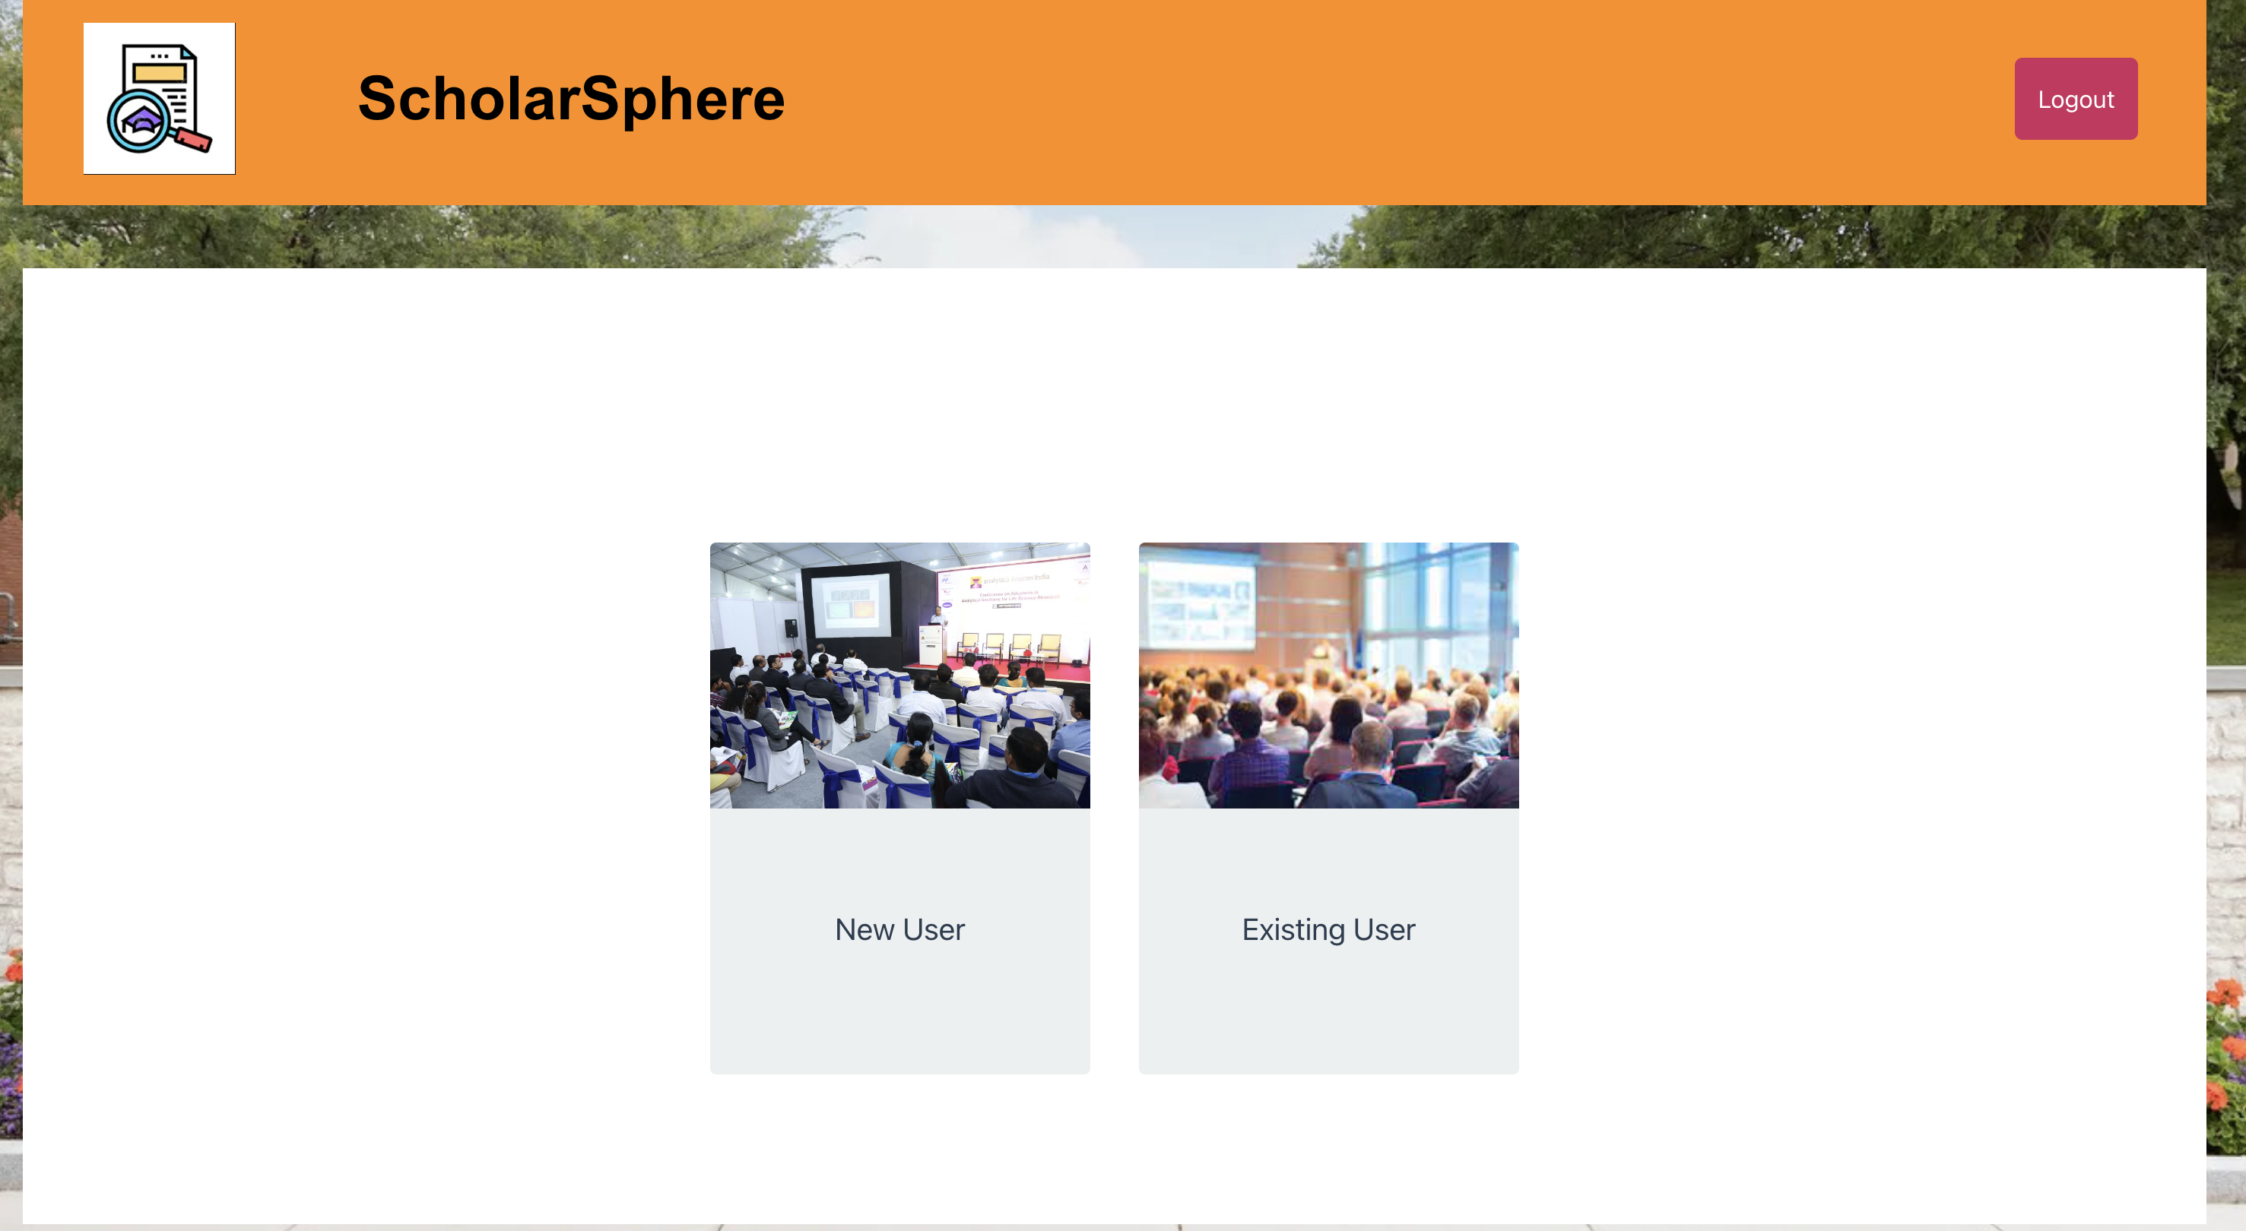
Admin Interface:

Slide 23
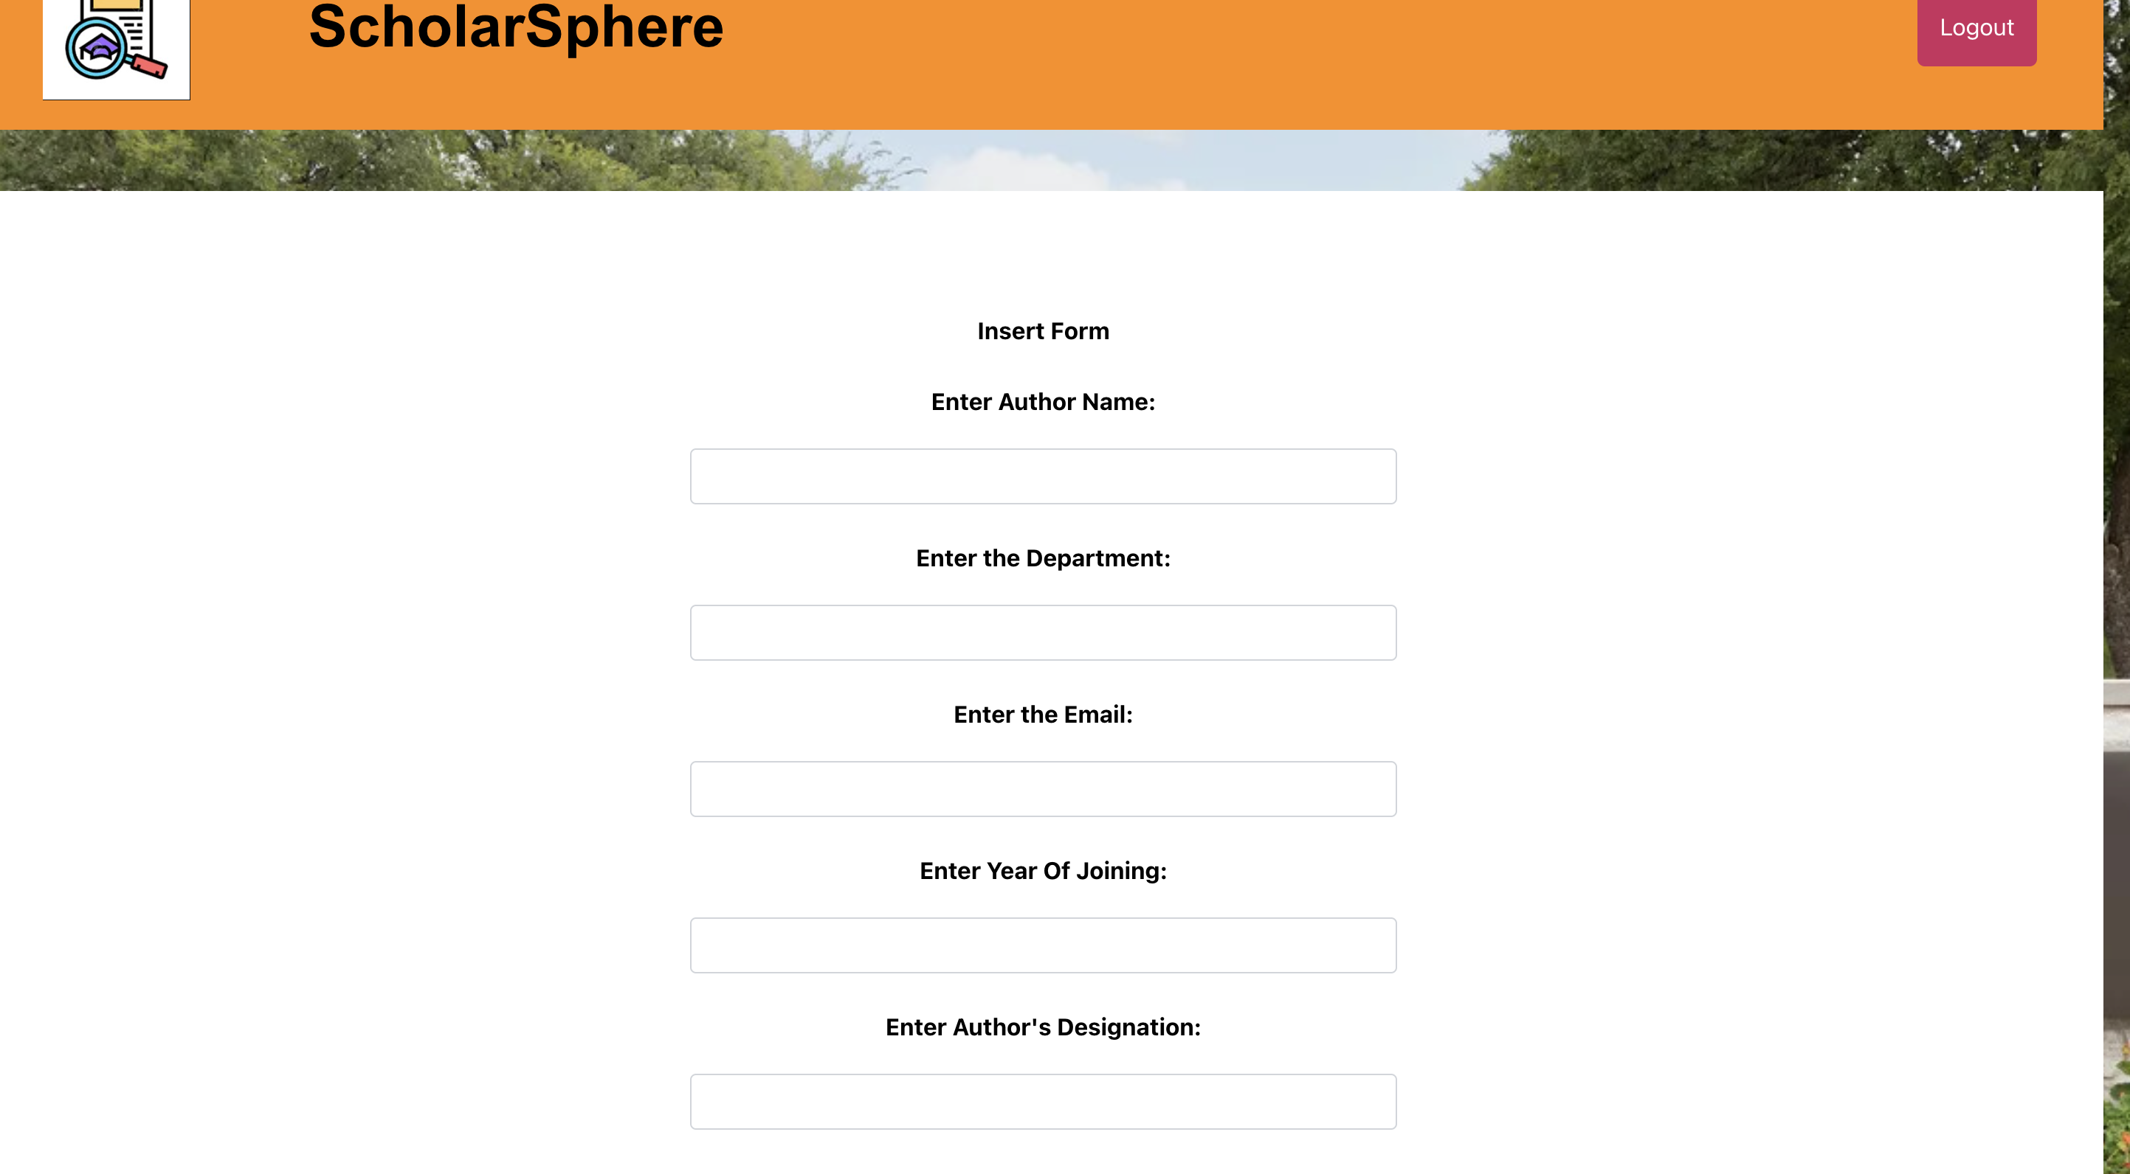
Admin Interface:

Slide 24
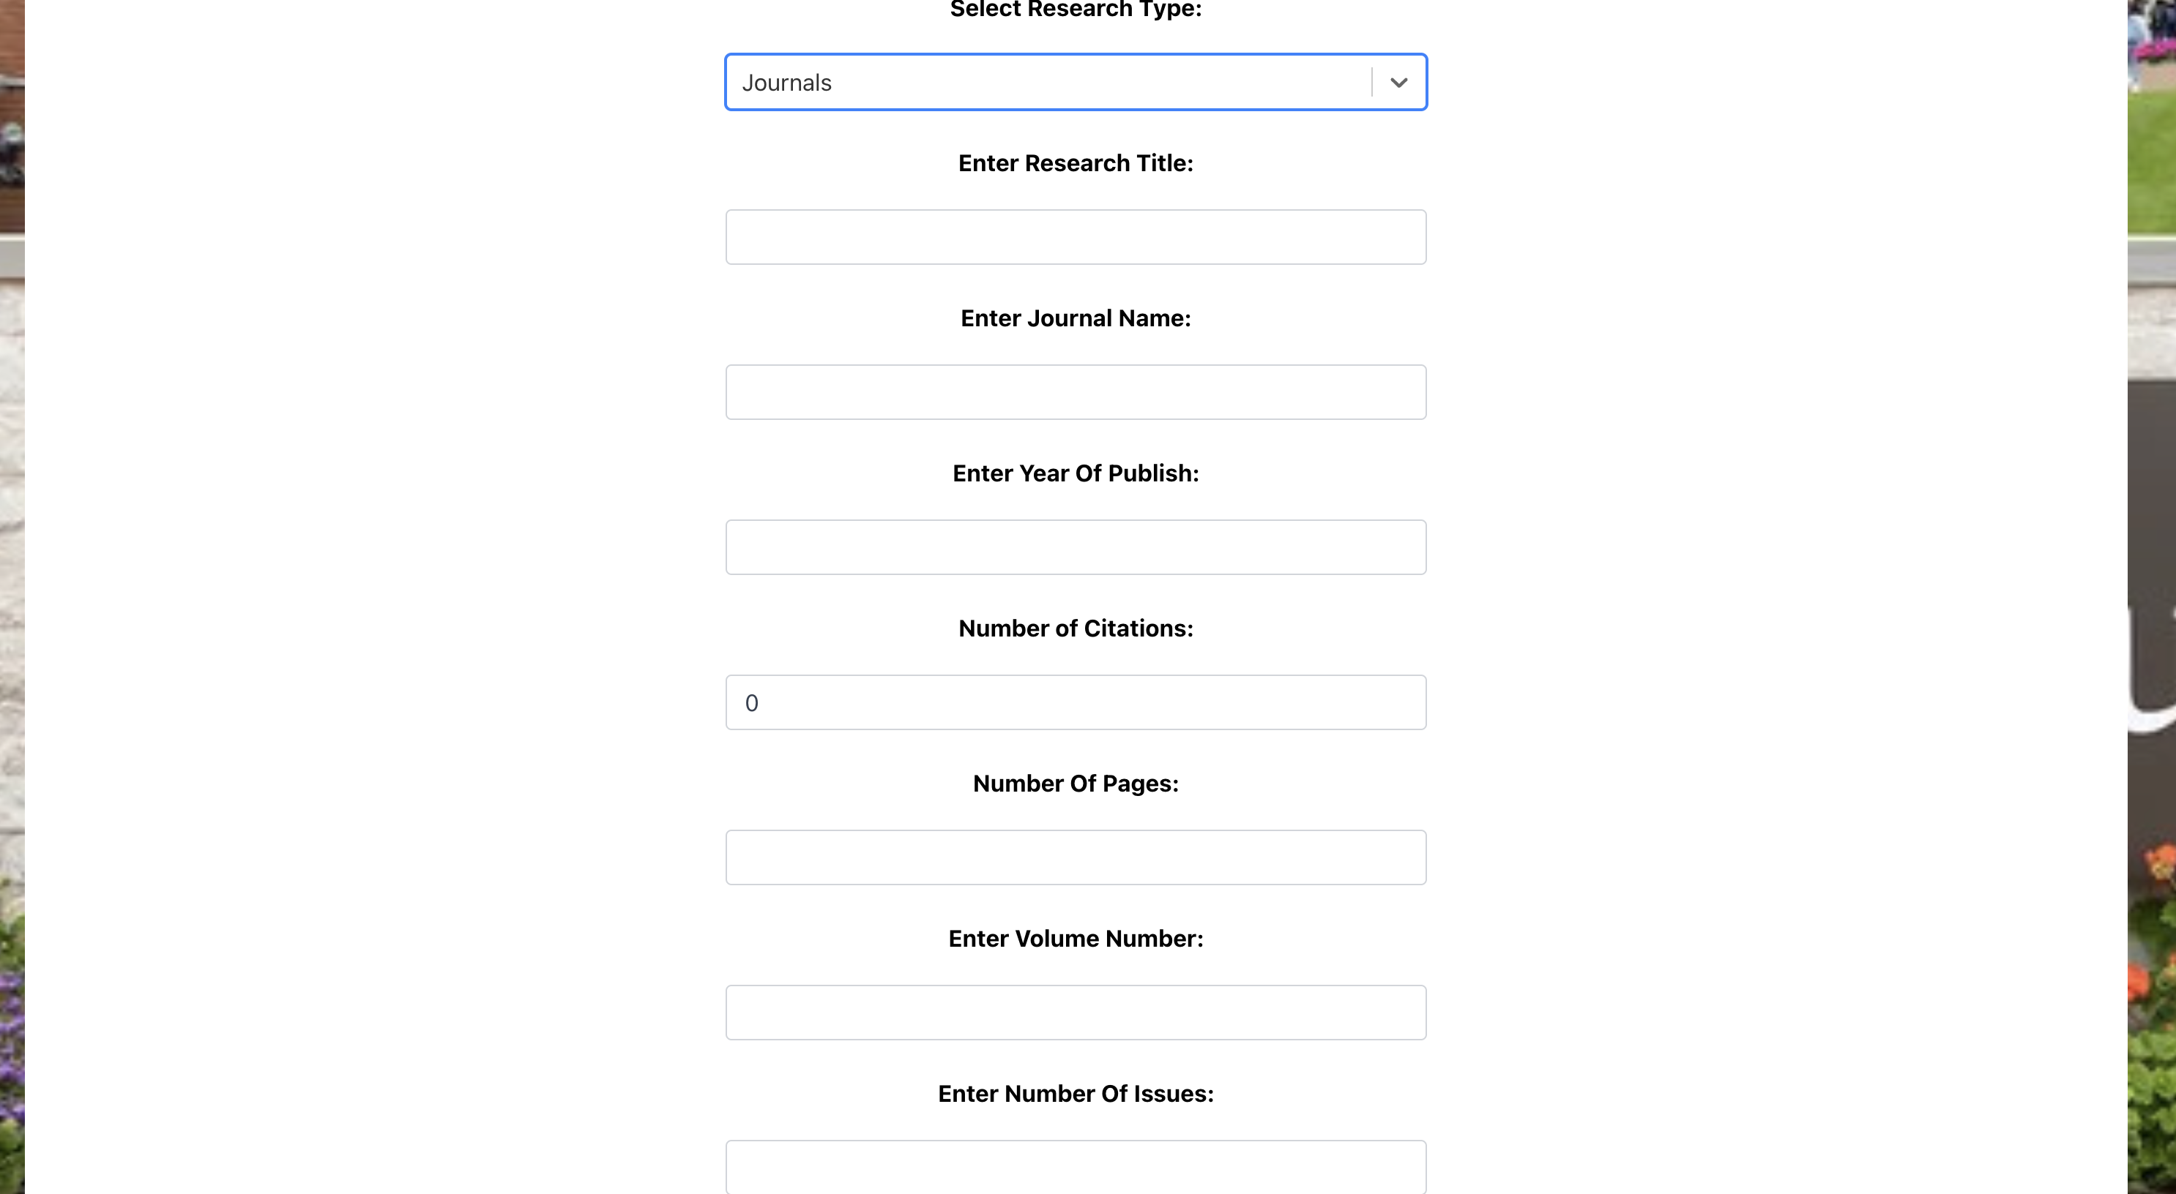
Admin Interface:

Slide 25

Admin Interface:

Slide 26
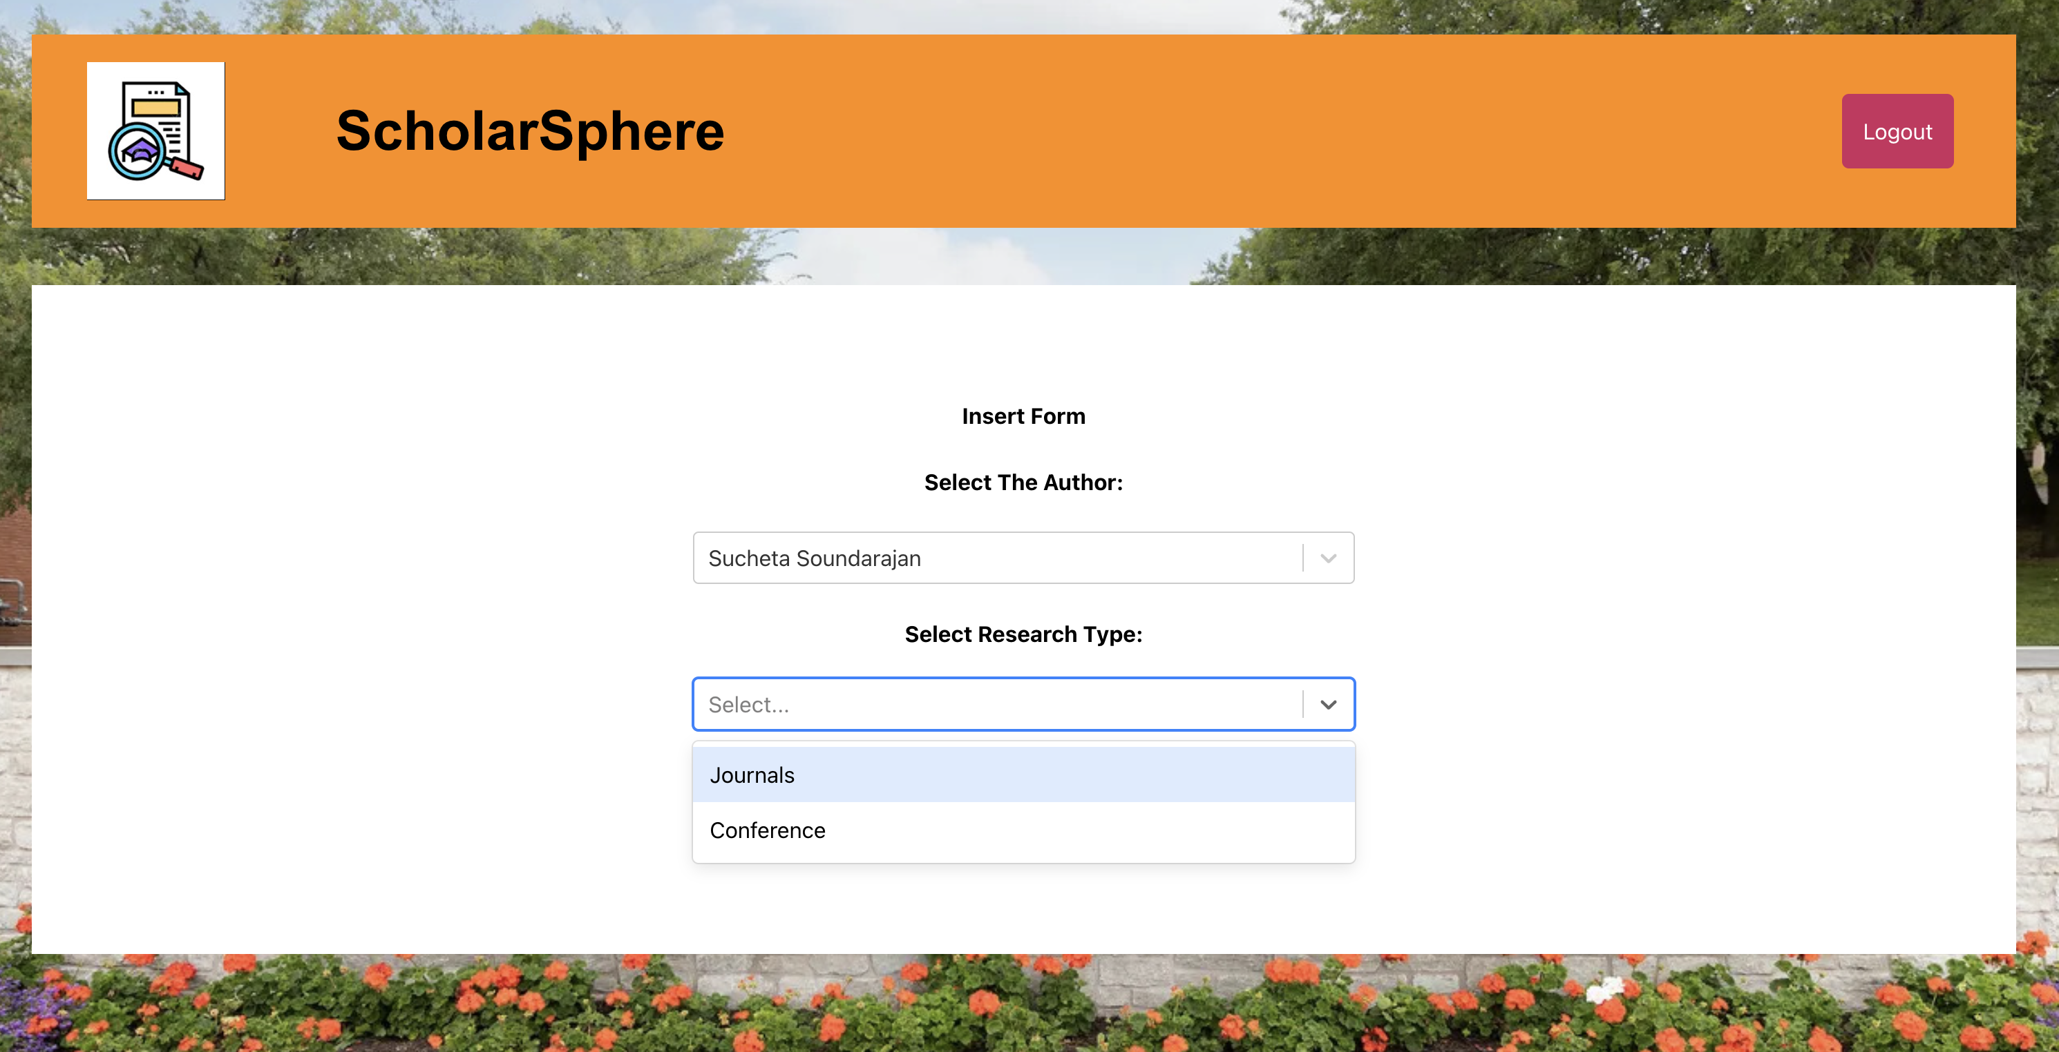
Admin Interface:

Slide 27
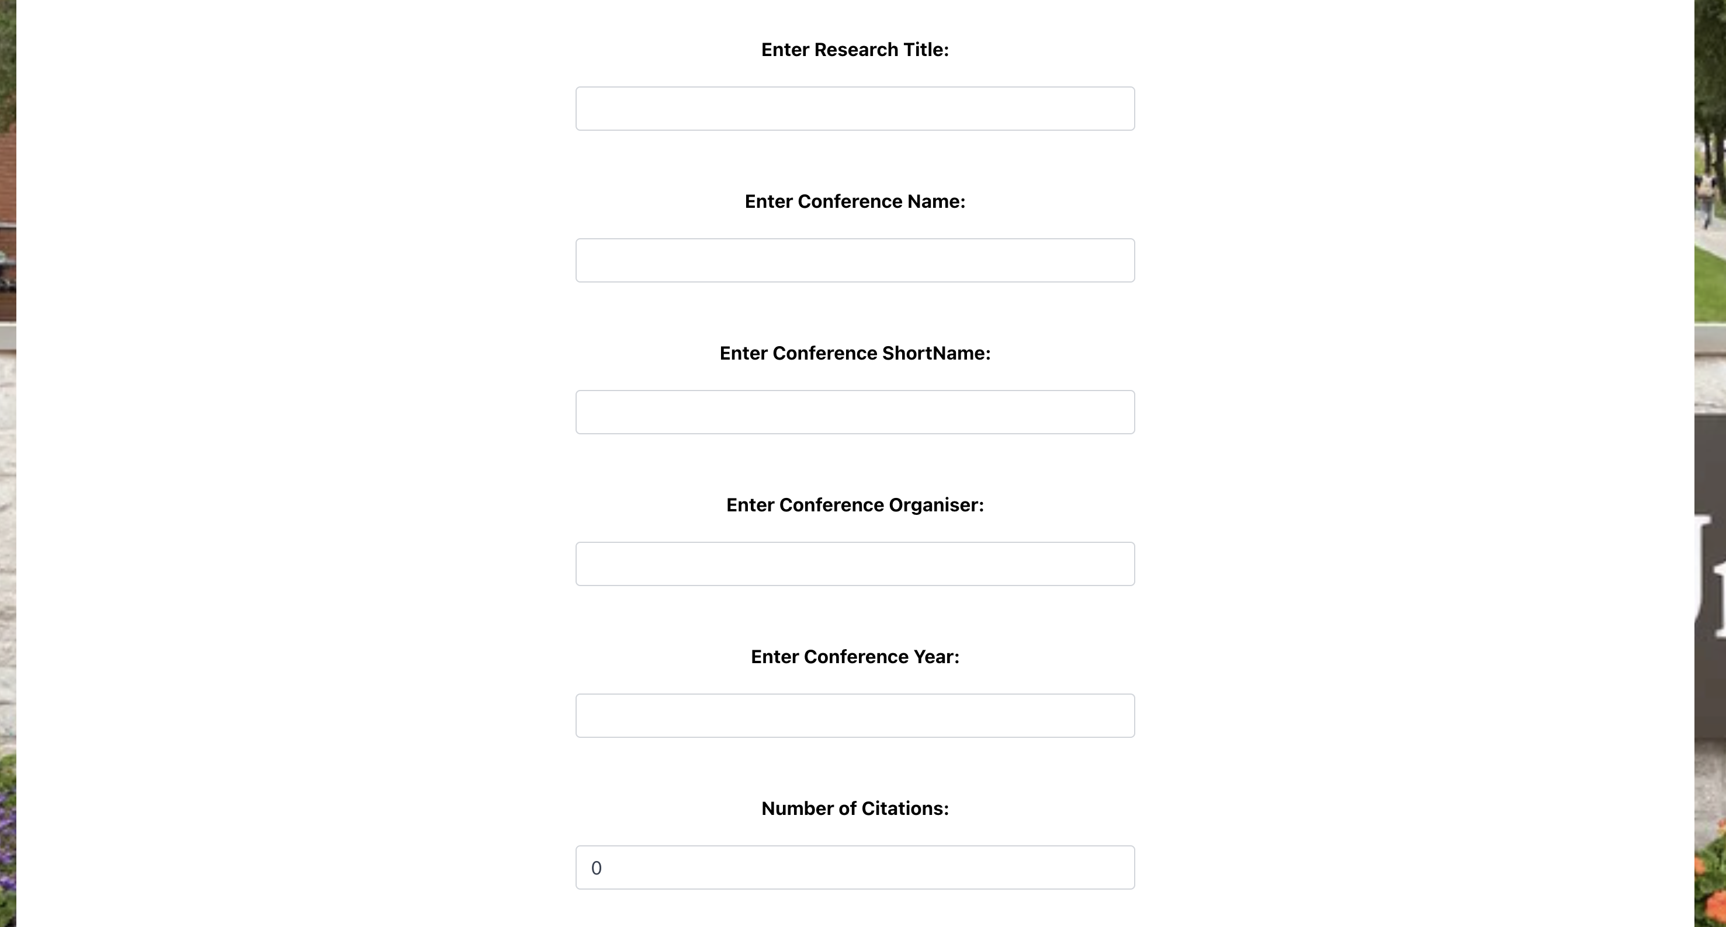
Admin Interface:

Slide 28

Admin Interface:

Slide 29
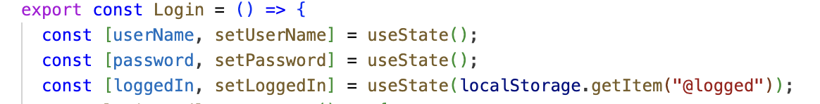
Abstraction
Definition: It is the process of focusing on the essential features of a system or a process while ignoring less relevant or overly detailed aspects. This is typically achieved through the creation of models or interfaces that represent the more significant features without involving all the underlying complexities.
Abstraction Implementation:
Login.js
The use of React functional components (Login) and state management via hooks (useState) abstracts the state management logic. The user of the Login component need not understand the intricacies of how states like userName, password, and loggedIn are managed internally.
Usage:
React Components: Simplifies UI code management by allowing us to think about each piece in isolation.

Slide 30
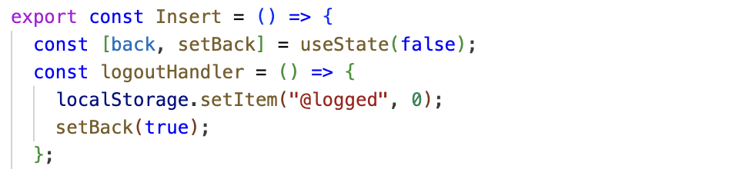
Insert.js
The use of components (Insert) and hooks (useState) abstracts complex functionalities like redirecting users or handling state changes upon actions (e.g., logging out).
Usage:
React Components: Allows the developer to modularize features such as inserting new user data, making the code easier to manage and scale.
Logout Functionality: Encapsulates the logout logic, making it reusable and easy to maintain across different parts of the application where a logout feature might be necessary.

Slide 31
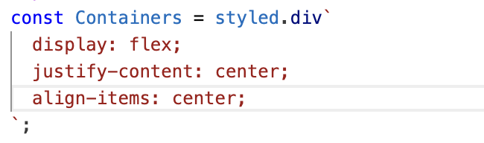
Encapsulation
Definition: It refers to the bundling of data with the methods that operate on that data. Encapsulation is used to hide the values or state of a structured data object inside a class, preventing unauthorized parties' direct access to them.
Encapsulation Implementation:​
Login.js​
Usage:
Styled components (Containers) encapsulate styles within specific components, preventing style leakage and collisions across the application. The Containers styled component defines CSS that is specific to it and not accessible or modifiable from outside unless explicitly allowed.

Slide 32
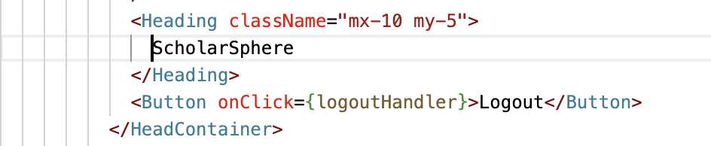
Insert.js​
The logoutHandler function encapsulates the logic required to log a user out. It directly interacts with the browser's local storage and state management without exposing the details to the outside.
Usage:
Logout Functionality: Encapsulates the logout logic, making it reusable and easy to maintain across different parts of the application where a logout feature might be necessary.

Slide 33
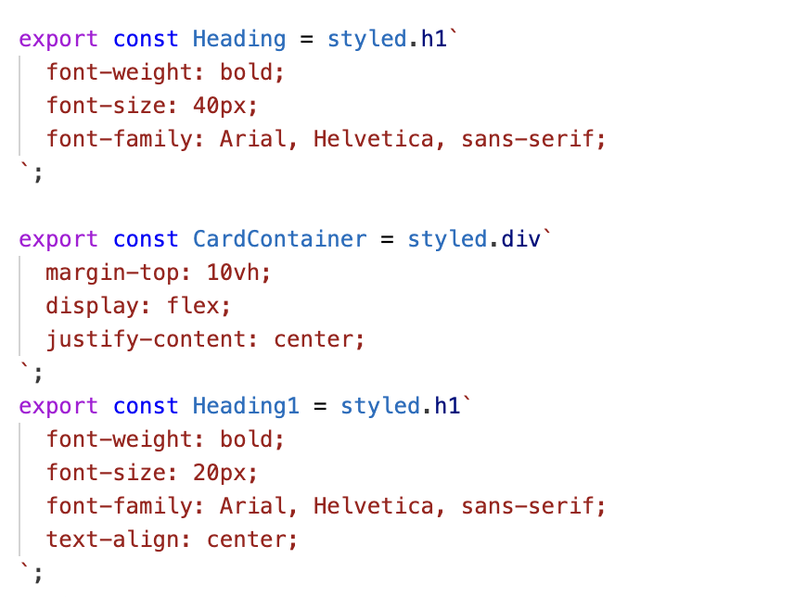
Inheritance
Definition: It is a mechanism where you can derive a class from another class for a hierarchy of classes that share a set of attributes and methods.
Inheritance Implementation:​
SearchInterNational.js​​
Usage:
Each component such as Button, Label, or Heading begins with a base HTML element (like <button>, <label>, <h1>, <div>) and extends it. This extension is analogous to how a subclass in OOP inherits properties and methods from a superclass, but here, it's about inheriting and extending the basic HTML element's capabilities with additional styling and behavior specified in the backticks. The styled component then behaves like an enhanced version of the HTML element, encapsulating both its inherent properties and the new styles or behaviors specified

Slide 34
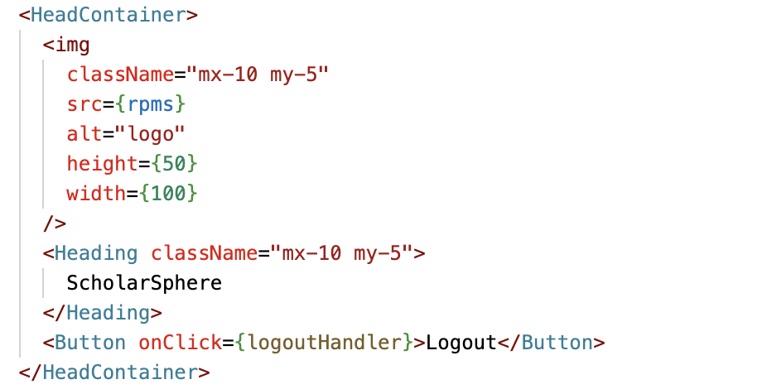
AdminSearch.js​​​
Usage:
In this structure, HeadContainer acts like a base component that encapsulates common functionality and styling for the header part of the component. Elements like Button and Heading are used within, inheriting the context and styling rules defined by HeadContainer.

Slide 35
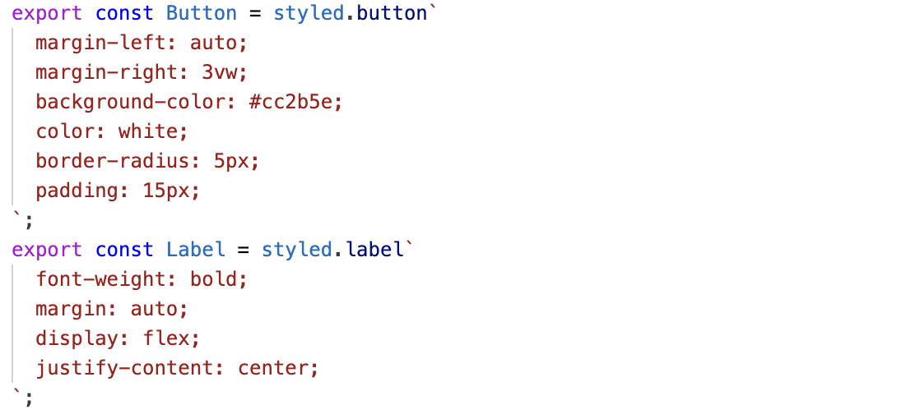
Polymorphism
Definition: It describes the ability of something to have or to be displayed in more than one form. The different forms arise because these entities can be assigned different meanings and used in various ways in multiple contexts.
Polymorphism Implementation:​​
SearchInterNational.js​​​
Usage:
In this enhanced example, the Button styled component changes its background-color based on a primary prop, demonstrating how the same component can look different based on the properties it receives, akin to method overriding based on an object’s state.

Slide 36
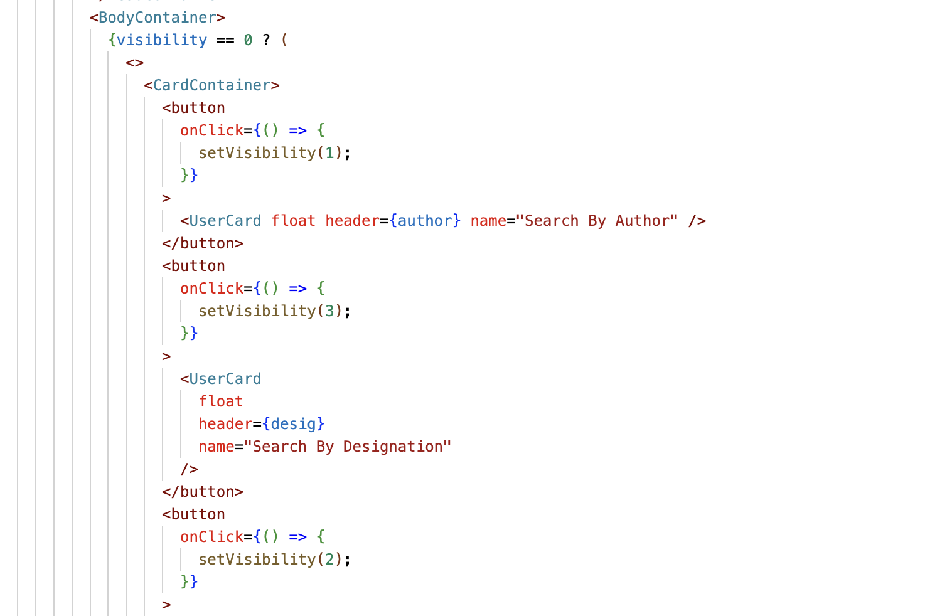
AdminSearch.js​​​​
Usage:
The component changes what it renders based on the visibility state. This can be seen as a form of polymorphic behavior where the component's response is different depending on the state's value. This is similar to how a method in a polymorphic class might behave differently based on the subclass from which it is called.

Slide 37
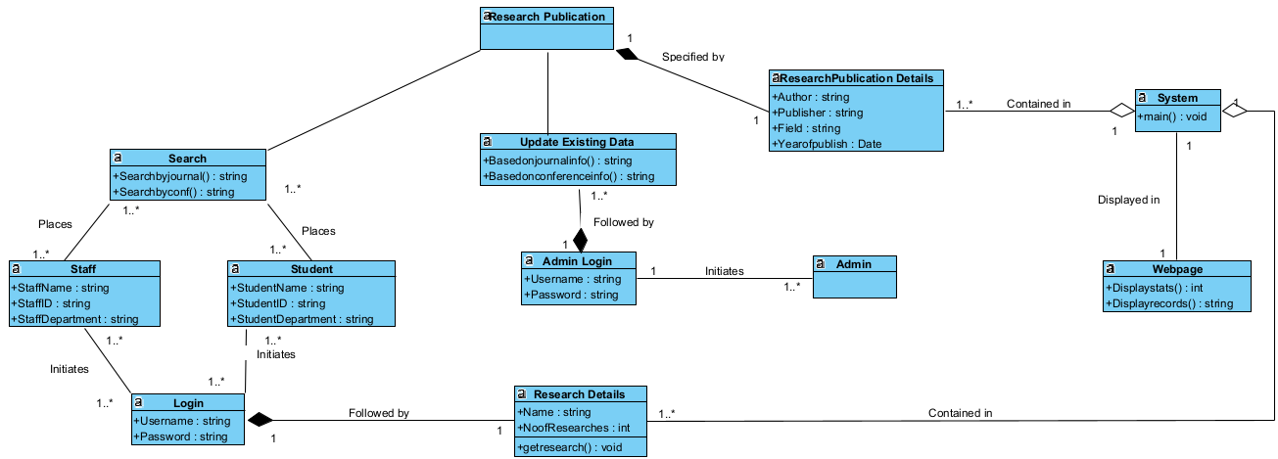
Class Diagram 1

Slide 38
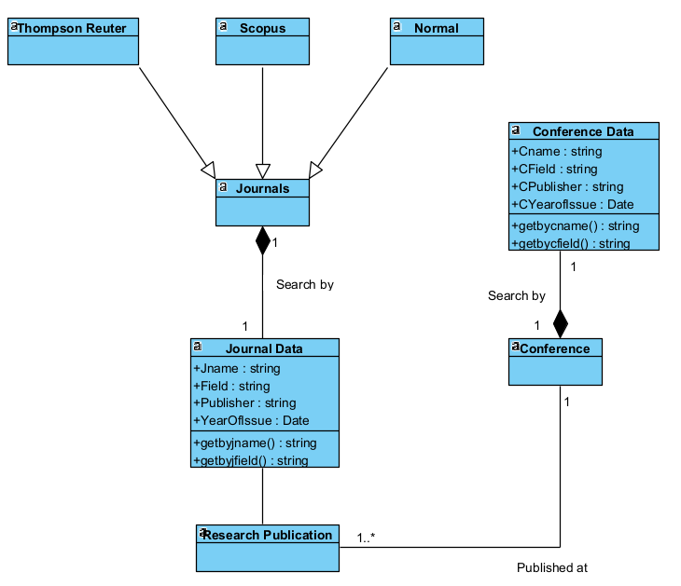
Class Diagram 2

Slide 39
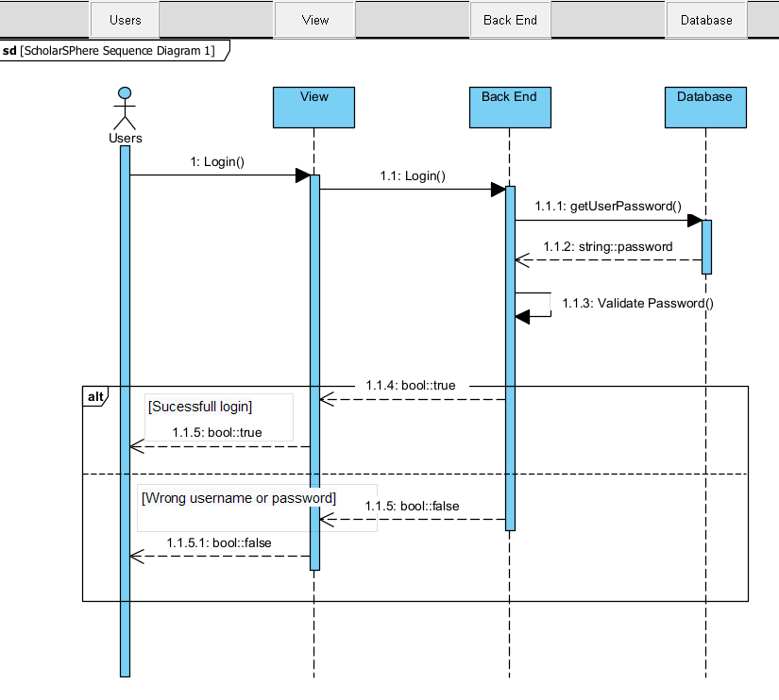
Sequence Diagram 1

Slide 40
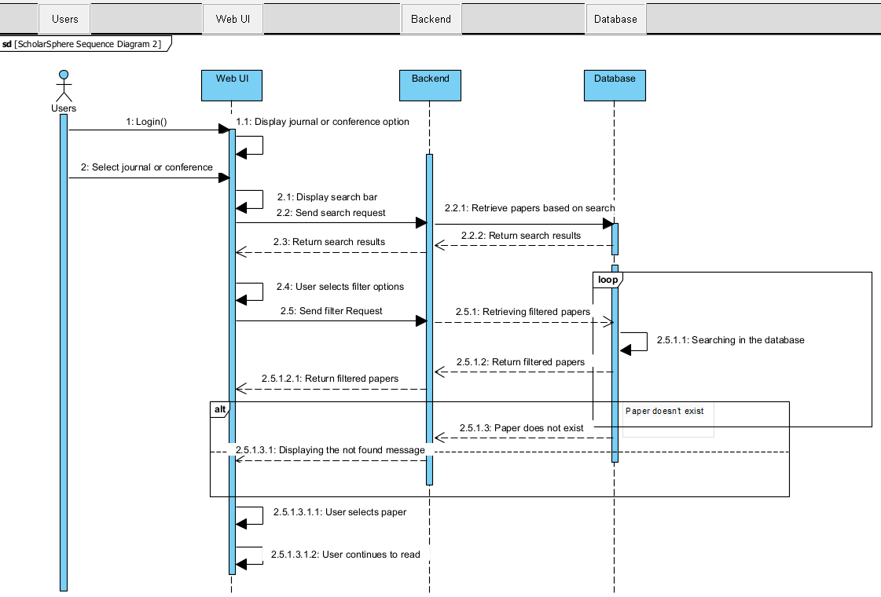
Sequence Diagram 2

Slide 41
Annexure
GitHub Links:
SRS File and VPP File
UML Diagram
Class Diagrams
Sequence Diagrams
Final Working Code

Slide 42
Thank you

